Slide 1
Reciprocating Compressor Periodic Testing with Portable Instrumentation
Intermediate Level
2018

Slide 2
The Reciprocating Compressor

Slide 3
Course Agenda
Compressor theory
Channel Resonance
Pressure – vibration - ultrasonic vs. crank-angle
Pressure vs. displaced volume
Theoretical pressure-volume models
Log P Vs. Log V plots
Flow profile
Rod load - rod run out - rod wear
Rod reversals
Priority and probability assignment
Performance information

Slide 4
Skid & Accessory Condition
Gas path sizing
Bottles, lines, scrubbers
Restricted construction screens
Instrumentation defects
Leaking by-pass and recycle valves
Excessive vibration / support deficiencies
Skid
Vessels
Valves
accessories

Slide 5
Detectable Compressor Malfunctions
Valves and un-loaders
Improper clearances
Pocket component condition
Piston / ring / rider condition
Liner condition
Mechanical looseness
Rod load / rod reversal / run-out
Pulsation problems
Poor efficiency

Slide 6
Compressor Rod Motion
Rotation is not needed
Con Rod length
Radius
Piston or Crosshead
Setup Requirements:
Connecting rod length
Stroke (in inches)
The radius is used in the actual calculations (stroke/2)
Stroke

Slide 9
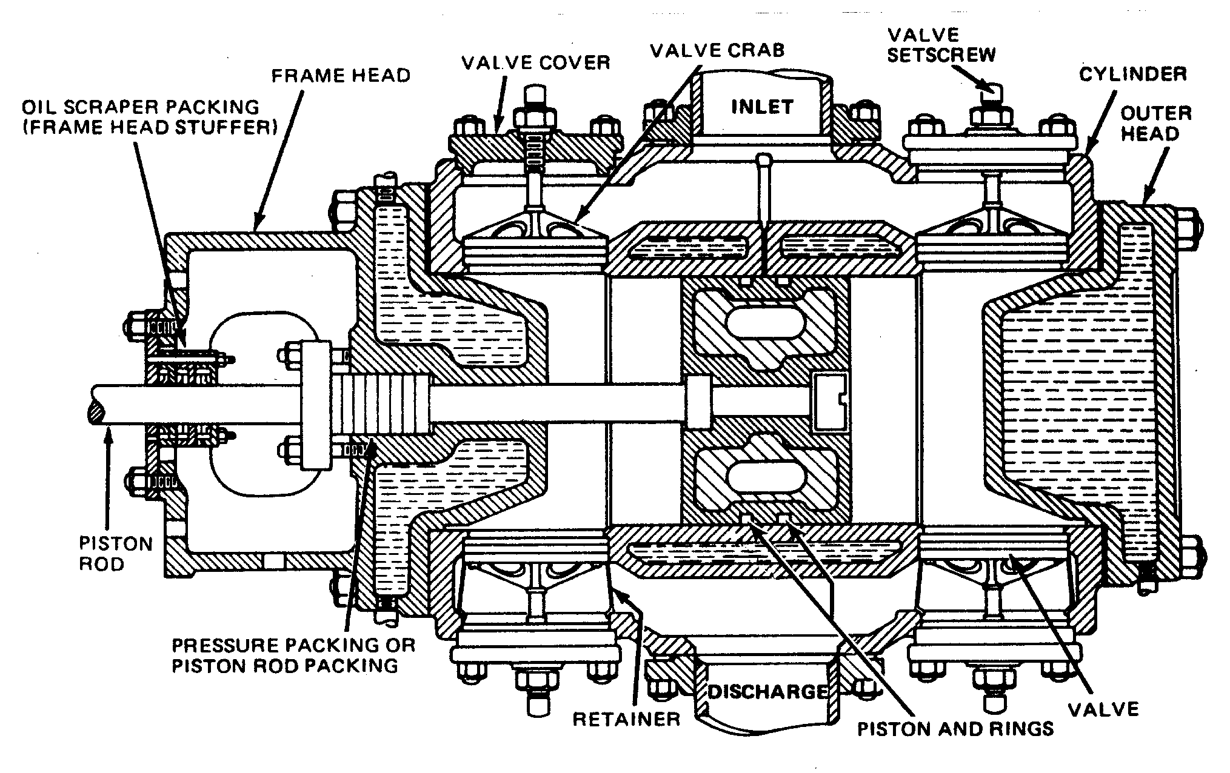
Typical Compressor Cylinder
©Copyright 2003, Dresser-Rand Company. All Rights Reserved

Slide 10
Compressor Pressure
Compressor calculations use absolute pressure
Absolute pressure = gauge pressure + atmospheric pressure
(100 psig + 14.7 = 114.7 psia)
(200 psig + 14.7 = 214.7 psia)
The atmospheric pressure at the test location is not corrected to sea level
Compression ratio = absolute discharge pressure divided by absolute suction pressure
(214.7 psia / 114.7 psia = 1.872 CR)
Standard pressure or standard atmosphere is the pressure of a standard cubic foot of gas

Slide 11
Boyle’s 1st Law
If temperature remains constant, the volume occupied by a given weight of gas varies inversely with its absolute pressure.
As the volume of gas is reduced, its pressure increases.
P1*v1 = p2*v2
20 psia * 10 cu. Ft. = 40 psia * 5 cu. Ft
If the volume reduces to half of its original size, the absolute pressure doubles (a 50% reduction in total volume will cause a 100% increase in absolute pressure)

Slide 14
Compressor Temperature
Theoretical compressor calculations use absolute temperature (deg Rankine)
Absolute temperature (R) = degrees F + 460
(60 deg F + 460) = 520 deg R

Slide 15
Boyle’s 2nd Law
If the volume of a given quantity of gas is held constant, the pressure varies directly with the absolute temperature.
When the volume of gas remains the same and the absolute temperature of the gas increases, the pressure increases proportionately.
P1/p2 = t1/t2
100 deg F = 560 deg R
200 deg F = 660 deg R
660 / 560 = 1.18
100 psia pressure raised from 100 deg F to 200 deg F will cause the pressure to raise to 118 psia.

Slide 17
Charles’ Law
If the absolute pressure remains constant, the volume of a gas increases proportionately with any increase in the absolute temperature.
As the temperature of the gas increases, the volume increases if the pressure remains the same.
V1/v2 = t1/t2
V = cubic foot (cu. Ft.)
T = degrees Rankin = degrees F + 460

Slide 19
Ideal or Basic Gas Law
(P1*v1)/ t1 = (p2*v2)/ t2
P = absolute pressure
V = volume
T = absolute temperature
If this equation is not balanced, it means that:
There is leakage.
Internal (rings, valves, unloaders)
External (packing, etc)
There is temperature entering or leaving the process.

Slide 20
Critical Pressure & Temperature
Gases can be liquified by raising the pressure or lowering the temperature.
The highest temperature at which a gas can be liquified by increasing pressure alone is referred to as the critical temperature.
The pressure required to liquify a gas at its critical temperature is called its critical pressure.

Slide 21
Definitions
Displaced Volume – The volume the piston displaces as it move from Top Dead Center (TDC) to Bottom Dead Center (BDC) of the cylinder.
Clearance Volume – The volume remaining in the cylinder when the piston reaches Top Dead Center (TDC).
= Total Volume – Displaced Volume

Slide 22
Relationships
Force = Pressure * Area
Work = Force * Distance (stroke)
Power = Work/Time
Compressor Cylinder Horsepower Relationships
Brake Horsepower = Indicated Horsepower + Friction Horsepower
Brake Horsepower = Indicated Horsepower / compressor mechanical efficiency
Friction Horsepower
Ring/Liner friction
Wrist pin/Bushing friction
Connecting rod bearing/ crankshaft friction

Slide 23
Indicated Horsepower
The horsepower measured at the compressor piston face with an indicating device (e.g. 100 IHP).
Includes all thermodynamic losses
Flow restriction and pulsation
Thermodynamic losses (e.g. 15) are equal to the indicated horsepower (e.g. 100) minus the theoretical horsepower (e.g. 85)
Thermodynamic or compression efficiency equals theoretical horsepower (e.g. 85) divided by the indicated horsepower (e.g. 100). [ 85/100 = 85%]

Slide 24
Compressor Indicated Horsepower 1 Horsepower = 33,000 ft-lb/minute
IHP = PLAN/33,000
P = IMEP (indicated mean effective pressure)
L = STROKE ( in feet)
A = AREA (in square inches)
N = RPM (of compressor)

Slide 25
Crank-angle Plots are
Used for Performance Information and Mechanical Condition evaluation

Slide 26
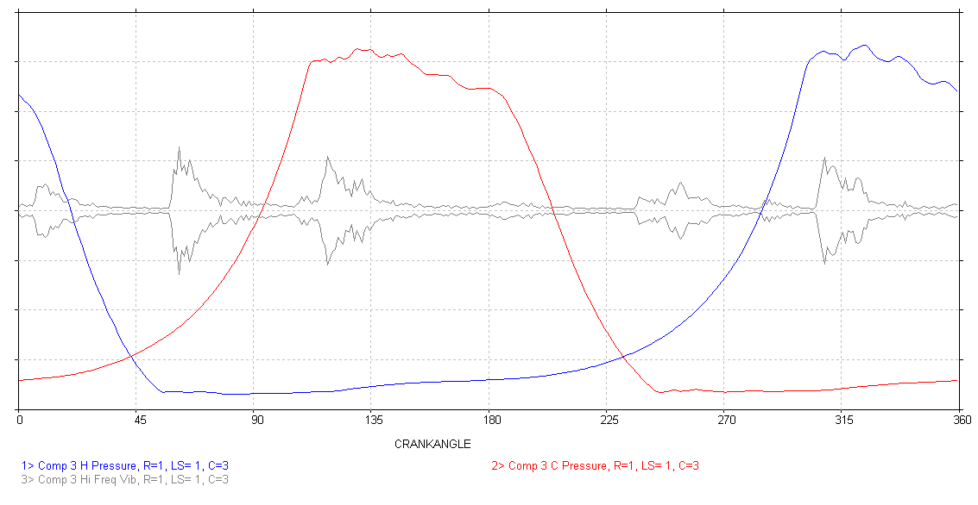
Waveforms Displayed Vs. Crank-Angle
HE pressure
CE pressure
Cylinder enveloped vibration (g’s)

Slide 27
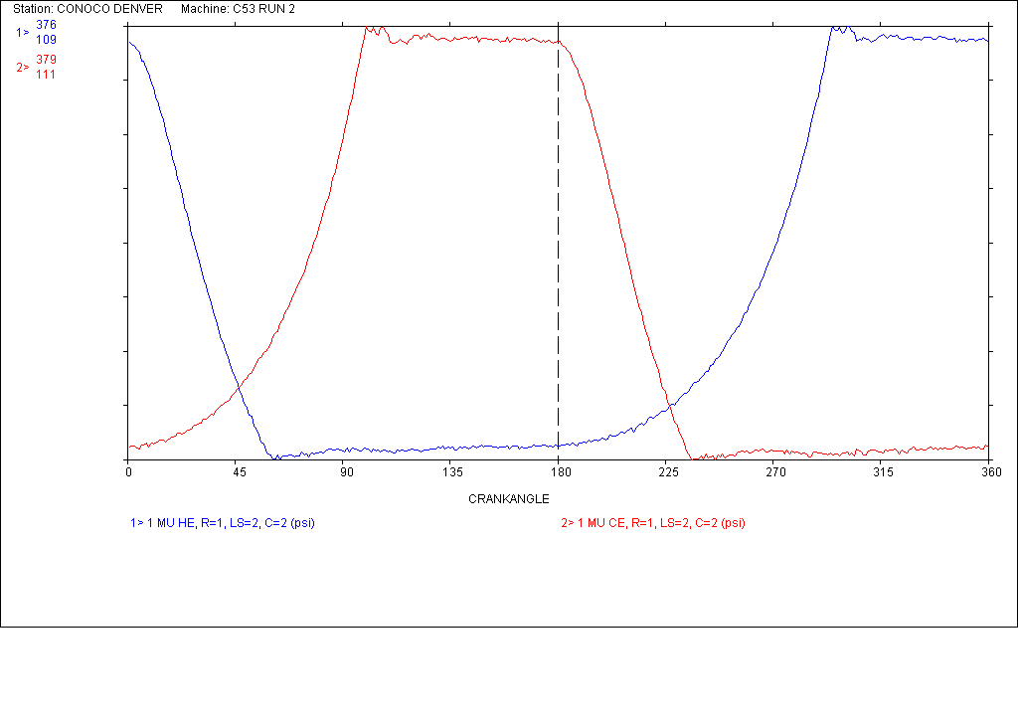
Toe Pressures
Crank-end Discharge toe pressure
Head-end Discharge toe pressure
TDC
BDC
TDC
Head-end Suction toe pressure
Crank-end Suction toe pressure

Slide 28
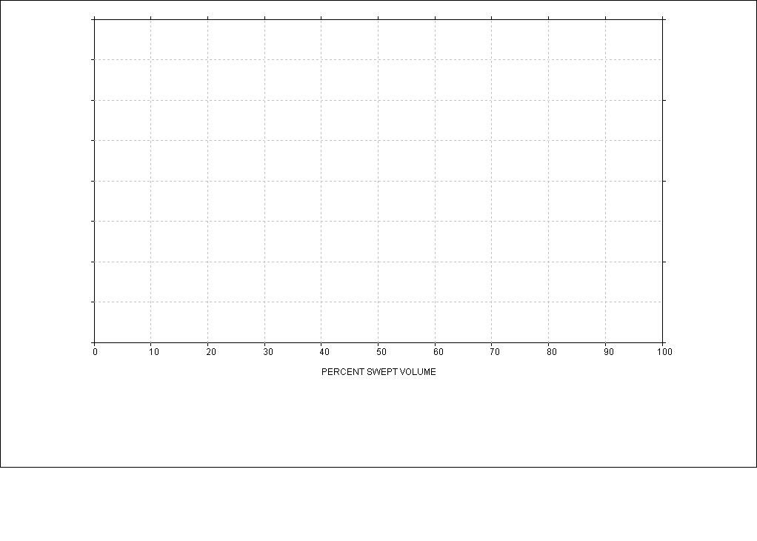
Percent Displaced Volume Display
TDC PISTON POSITION
PERCENT OF STROKE
BDC PISTON POSITION

Slide 29
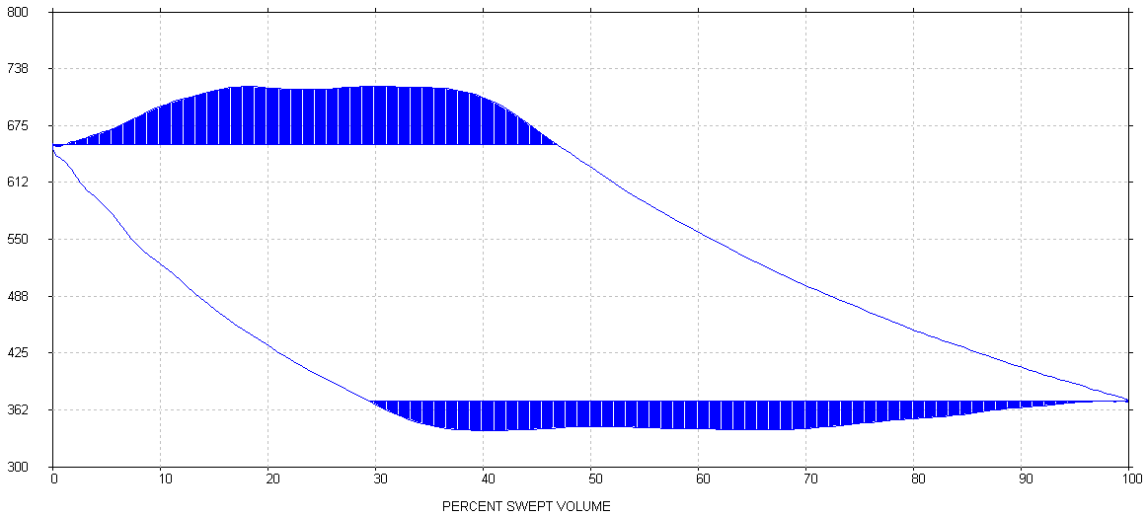
Head End Pressure Vs Volume (PV)
discharge
compression
expansion
Loss areas
suction

Slide 30
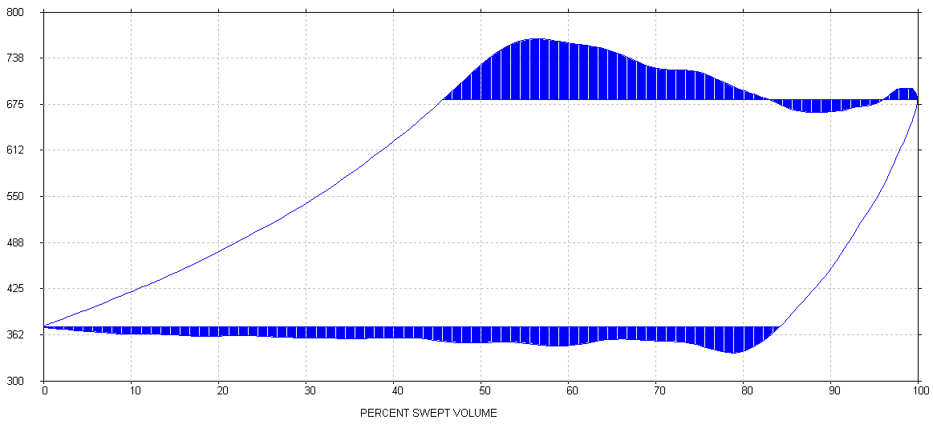
Crank End Pressure Vs Volume (PV)
discharge
compression
Loss areas
expansion
suction

Slide 31
Compressor Volumetric Efficiencies
Suction Volumetric Efficiency (VEs) is the percent of the cylinder end's displacement that the piston passes through after the internal cylinder pressure drops to suction pressure as determined by the pressure at the end of the stroke (suction toe).
Discharge Volumetric Efficiency (VEd) is the percent of the cylinder end’s displacement that the piston passes through after the internal cylinder pressure reaches discharge pressure as determined by the pressure at the end of the stroke (discharge toe).

Slide 32
Compressor (HE Volumetric Efficiencies)
Discharge VE
Suction VE

Slide 33
Compressor (CE Volumetric Efficiencies)
Discharge VE
Suction VE

Slide 34
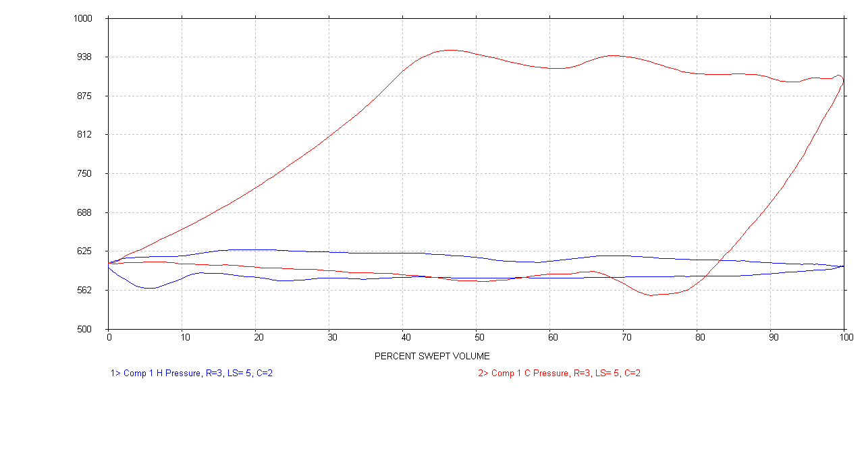
De-Activated Head-end
Head-end Suction and discharge volumetric efficiencies are 0

Slide 35
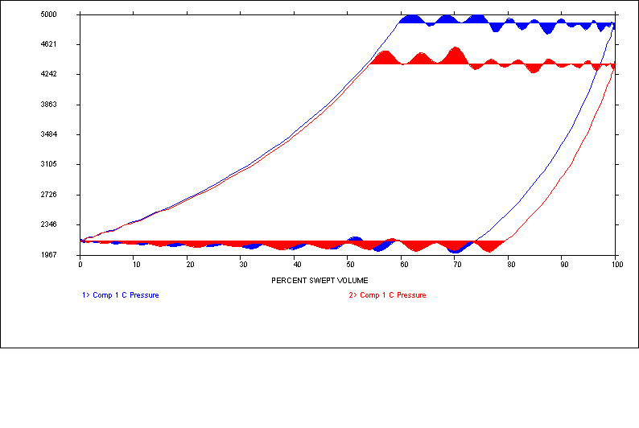
Volumetric Efficiencies Decreases When the Compression Ratio Increases
The flow rate decreases with an increase in compression ratio
and a decrease in volumetric efficiency

Slide 36
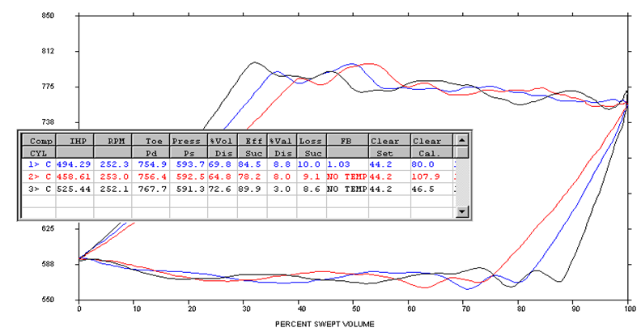
Volumetric Efficiency Decreases When Clearance Volume Increases (Flow rate decreases)
Discharge VE
Suction VE

Slide 37
Theoretical Discharge Temperature
Calculated from suction temperature, k-value and compression ratio
T2 = ((T1+460) * R^((K-1)/K))-460
T2 = Theoretical discharge temperature
T1 = Beginning temperature degrees F.
R = Absolute compression ratio
(absolute disch pr / absolute suct pr)
K = Ratio of specific heats
460 is used in the conversion between deg F and R

Slide 38
Theoretical Temperature Example
T1 = 60 deg F
R = 400 psia / 200 psia = 2
K = 1.28
T2 = ((T1+460)*R^((K-1)/K))-460
T2 = ((60+460)*2^((1.28-1)/1.28))-460
T2 = (520*2^(.28/1.28))-460
T2 = (520*2^(.21875))-460
T2 = (520*1.1637)-460
T2 = (605.124)-460
T2 = 145 deg F

Slide 39
Capacity
scfd = (dv * VE * rpm * 1440 * pressure correction * temperature correction) / Z (1440 is minutes in a day)
scfd = flow in std cu ft of gas/day
dv = area*stroke/1728 (1728 is cu inches in a cu ft)
VE = volumetric efficiency
rpm = compressor shaft revolutions per minute
pressure correction = absolute pr / standard pr
temperature correction = 520/absolute temperature (520 is std temp in deg R)
Z = compressibility (compensates for the compression characteristics of the gas)
Calculated at suction and/or discharge conditions
mmscfd = scfd/1,000,000

Slide 40
Flow Balance
The calculated suction flow rate divided by the calculated discharge flow rate.
A result greater than 1.0 indicates gas leaking out of the cylinder into a low pressure area.
A result less than 1.0 indicates gas leaking into the cylinder from a high pressure area.

Slide 41
“Smoothing”
Smoothing is a method of correcting the collected pressure data for inherent indicator passage resonance.
The indicator passage from the cylinder surface to diaphragm of the pressure sensor commonly changes diameter, length, and physical geometry.
These changes are the cause of the acoustical resonance somewhere in the 360 degrees of crank-angle pressure data.
This acoustical resonance typically does not effect the horsepower measurement because it is sinusoidal in nature.
If this acoustical resonance is present during the compression and re-expansion portions of the pressure trace, it can effect the measured toe pressure and Volumetric Efficiency picks.

Slide 42
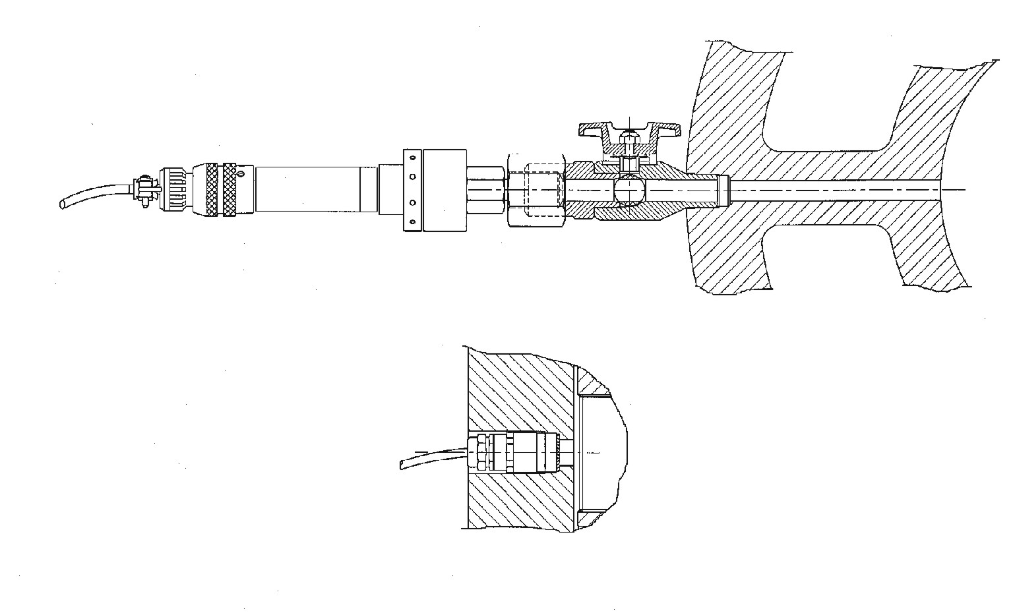
Indicator Passage
Indicator passage length and diameter have the biggest effect
on the passage resonance characteristics
Passage length affects the frequency
Longer passage has lower frequency
Flush Mount Sensor
Passage diameter affects the amplitude
Larger diameters have higher amplitude waves

Slide 44
Smoothing
Crank-end Discharge toe pressure
Head-end Discharge toe pressure
TDC
BDC
TDC
Head-end Suction toe pressure
Crank-end Suction toe pressure
Some pressure data requires little or no smoothing

Slide 45
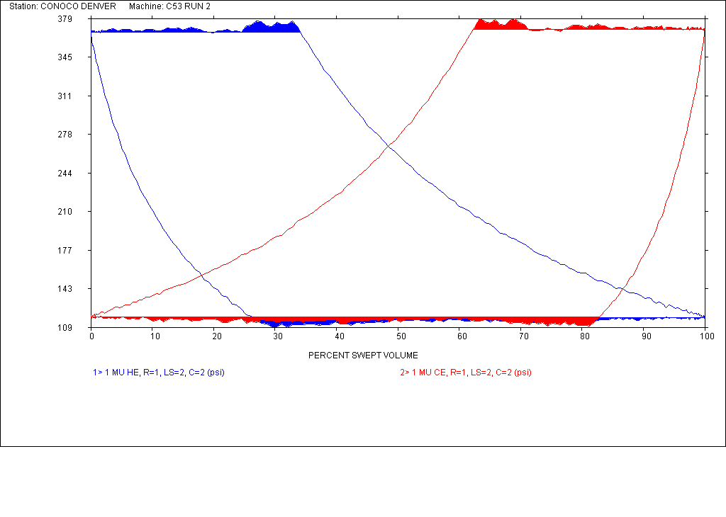
Smoothing
Some pressure data requires little or no smoothing

Slide 46
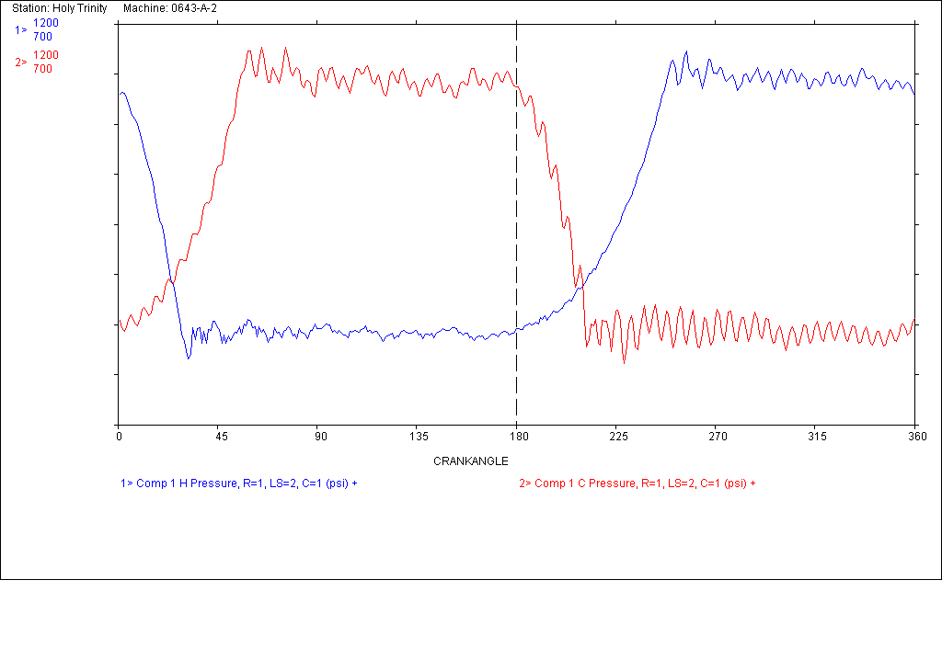
Smoothing
Some pressure data requires moderate smoothing (3)

Slide 47
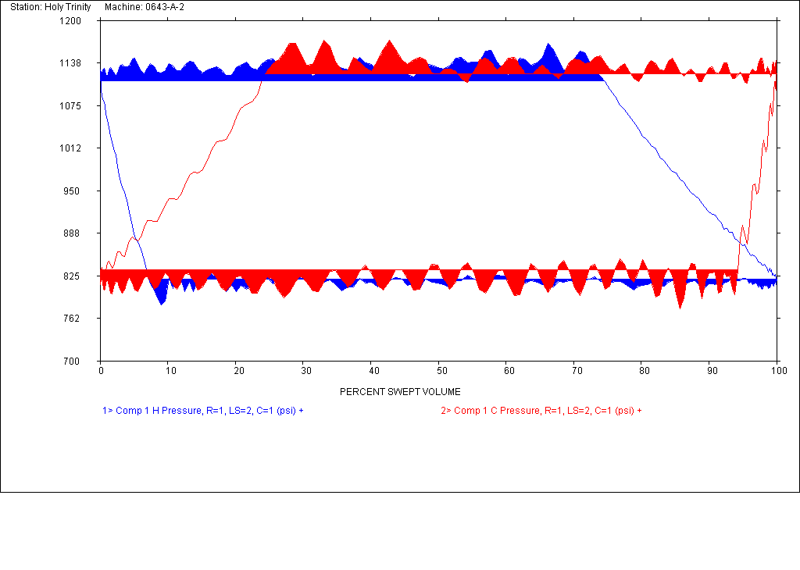
Smoothing
Some pressure data requires moderate smoothing

Slide 48
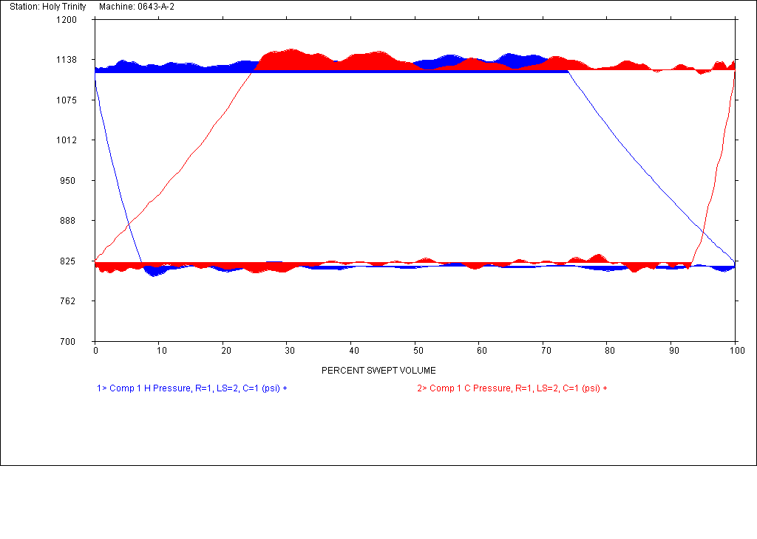
Smoothing
Some pressure data requires moderate smoothing

Slide 49
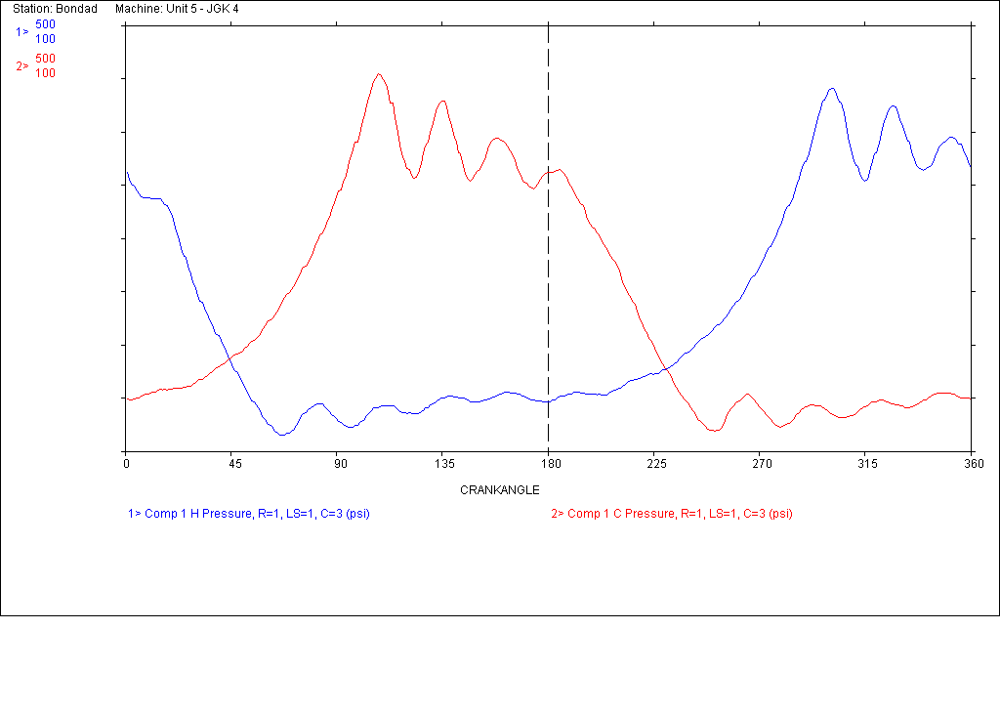
Smoothing
Some pressure data requires a greater amount of smoothing

Slide 50
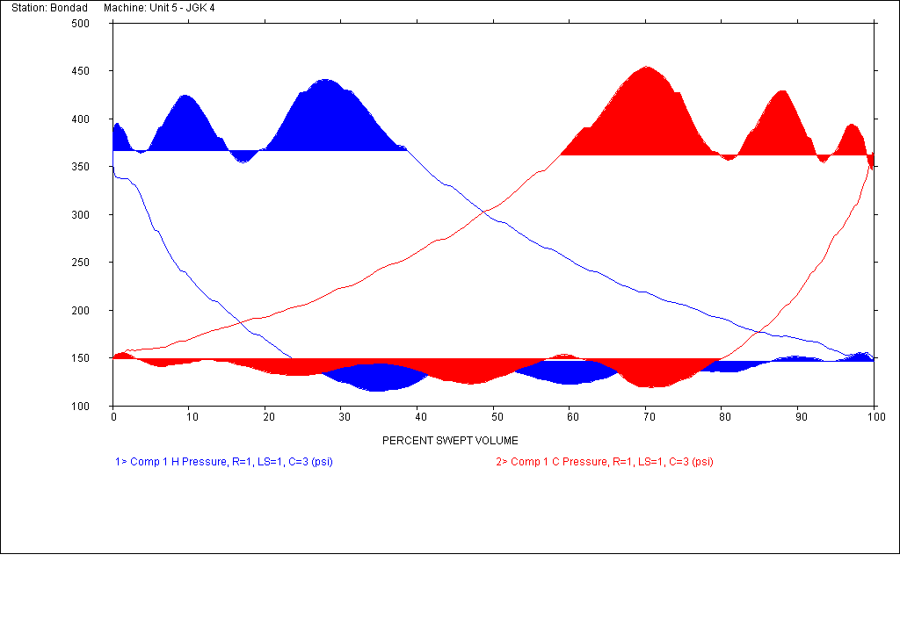
Smoothing
Some pressure data requires greater amounts of smoothing

Slide 51
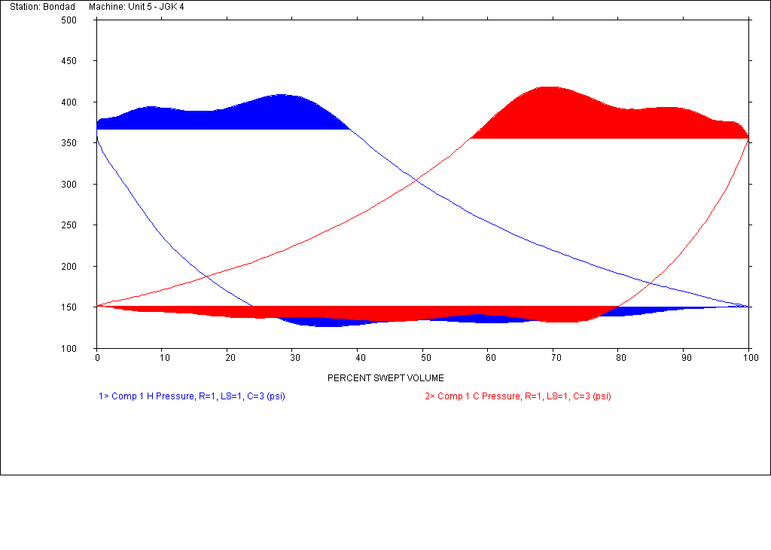
Smoothing
Some pressure data requires greater amounts of smoothing (11)

Slide 52
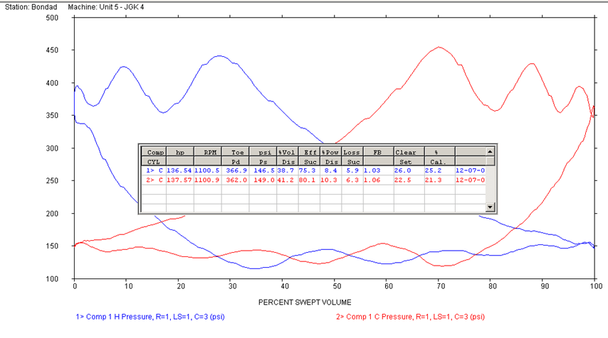
Application of Smoothing
Be careful not to over-smooth and change the horsepower

Slide 53
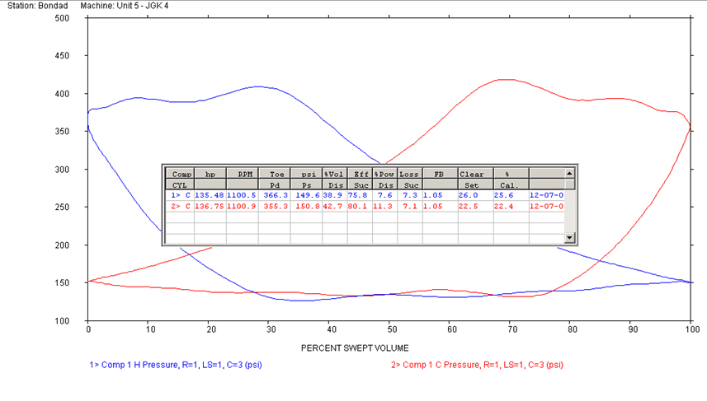
Smoothing
Be careful not to over-smooth and change the horsepower,
Toe pressure and VE picks

Slide 54
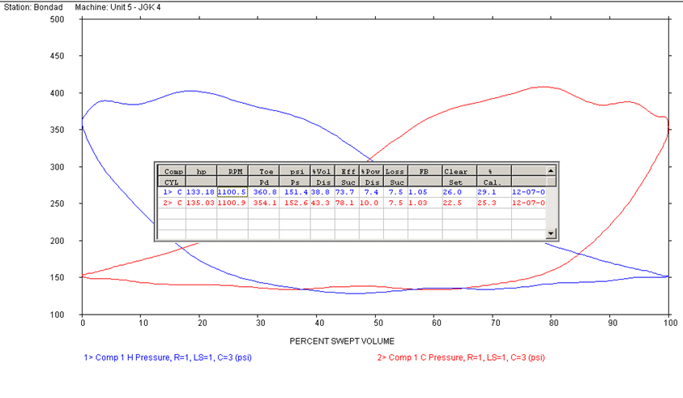
Smoothing
This is an example of too much smoothing

Slide 55
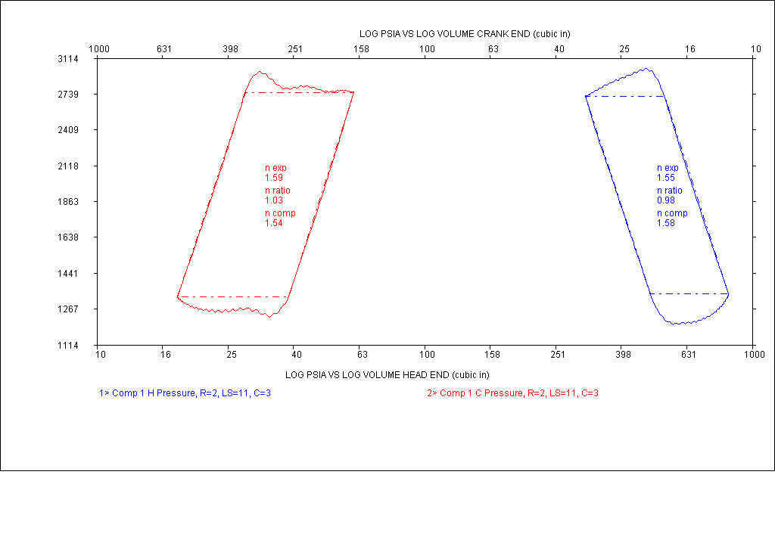
Log PSIA vs. Log Total Volume
Crank-end
Head-end
Log scales

Slide 56
Compression Models

Slide 57
Isothermal - This model assumes that the compressed gas remains at a constant temperature throughout the compression or expansion process. In this cycle, internal energy is removed from the system as heat at the same rate that it is added by the mechanical work of compression. Isothermal compression or expansion more closely models real life when the compressor has a large heat exchanging surface, a small gas volume, or a long time scale (i.e., a small power level). Compressors that utilize inter-stage cooling between compression stages come closest to achieving perfect isothermal compression. However, with practical devices perfect isothermal compression is not attainable. For example, unless you have an infinite number of compression stages with corresponding intercoolers, you will never achieve perfect isothermal compression.

Slide 58
Adiabatic - assumes that no heat is transferred to or from the gas during the compression, and all supplied work is added to the internal energy of the gas, resulting in increases of temperature and pressure. Theoretical temperature rise is T₂ = T₁·R_{c}^{(k-1)/k}, with T₁ and T₂ in degrees Rankine or kelvin, and k = ratio of specific heats. R is the compression ratio; being the absolute outlet pressure divided by the absolute inlet pressure. The rise in air and temperature ratio means compression does not follow a simple pressure to volume ratio. This is less efficient, but quick. Adiabatic compression or expansion more closely model real life when a compressor has good insulation, a large gas volume, or a short time scale. In practice there will always be a certain amount of heat flow out of the compressed gas. Making a perfect adiabatic compressor would require perfect heat insulation of all parts of the machine. A bicycle tire pump's metal tube becomes hot as you compress the air.

Slide 59
Polytropic - This model takes into account both a rise in temperature in the gas as well as some loss of energy (heat) to the compressor's components. This assumes that heat may enter or leave the system, and that input shaft work can appear as both increased pressure (usually useful work) and increased temperature above adiabatic (usually losses due to cycle efficiency). Compression efficiency is then the ratio of temperature rise at theoretical 100 percent (adiabatic) vs. actual (polytropic).

Slide 60
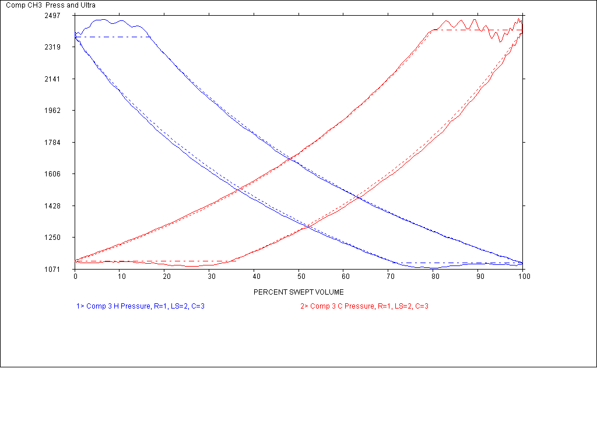
N Based Theoretical Overlay
The N compression and N-expansion values are derived from the actual slopes of the collected indicator card. When the theoretical lines are replotted they will always line up with the actual at the beginning and end of the slope. Do not need an accurate clearance for this to work. Limited diagnostic value.

Slide 61
Average N Based Theoretical Overlay
The N compression and N-expansion values are derived from the actual slopes of the collected indicator card and then averaged for each end. When the theoretical lines are replotted they may deviate from the actual at the beginning and end of the slope. Do not need an accurate clearance for this to work. Limited diagnostic value but better than N-value only.

Slide 62
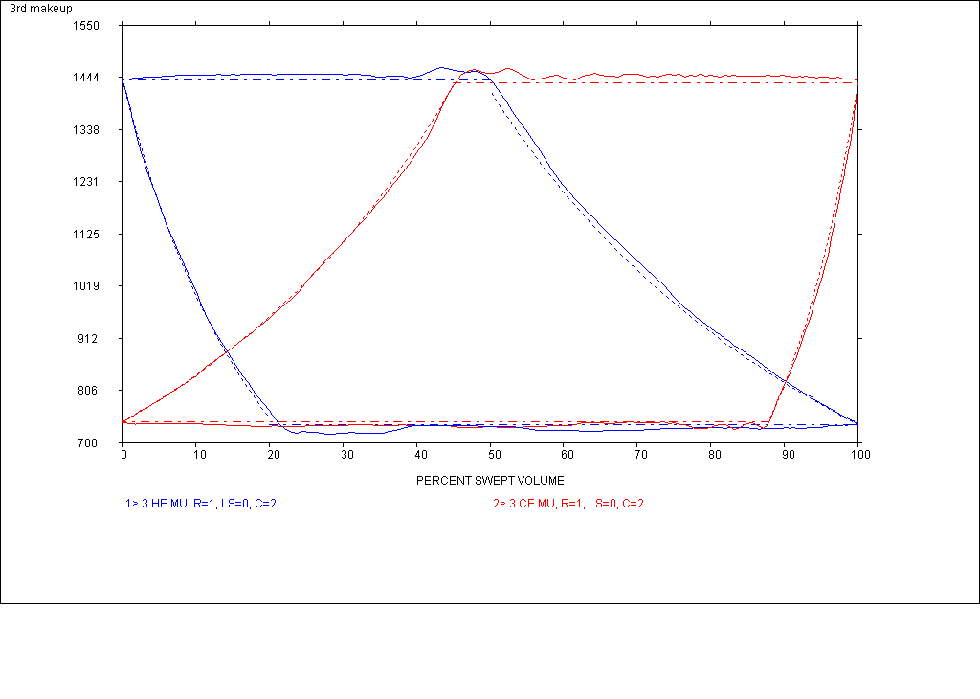
K Based Theoretical Overlay
The K values are derived from the gas analysis and modified by the average gas temperature. An accurate clearance value needs to be in the setup for the current load step. This plot is the best for diagnostic comparison with the collected PV when the Zs and Zd values are relatively close to each other. Use the average GPSA calculated clearance in the loadstep table if unsure of the actual clearance. Good diagnostic value.

Slide 63
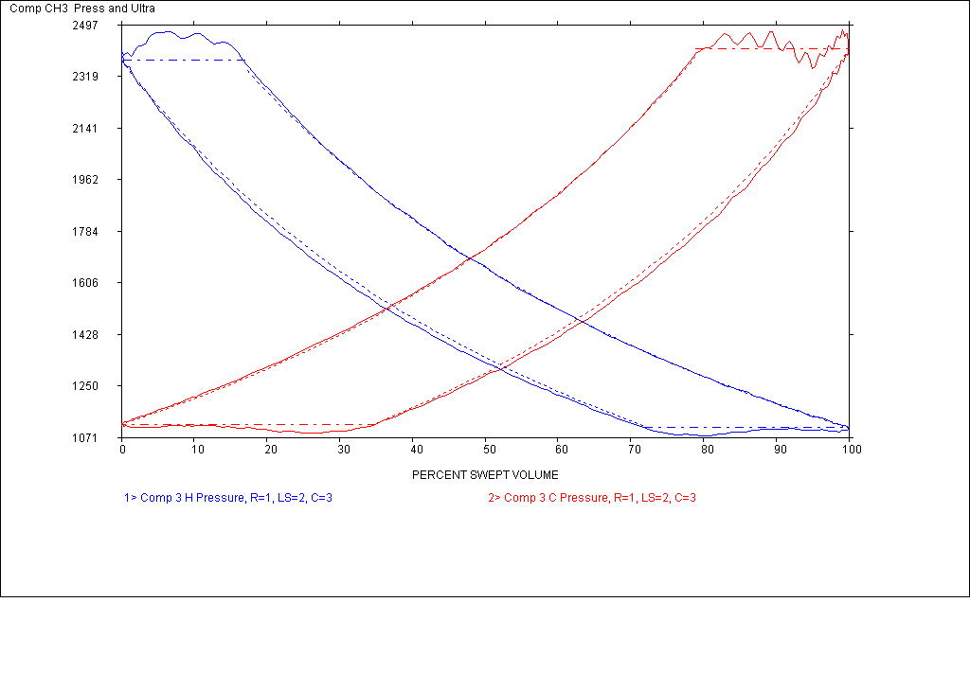
Eqn of State Model K Temp On
The K values are derived from the gas analysis and continuously modified by the theoretical gas temperature. An accurate clearance value needs to be in the setup for the current load step. This plot is the best for diagnostic comparison with the collected PV when the Zs and Zd values are significantly different to each other. Use the average GPSA calculated clearance in the loadstep table if unsure of the actual clearance. Good diagnostic value.

Slide 64
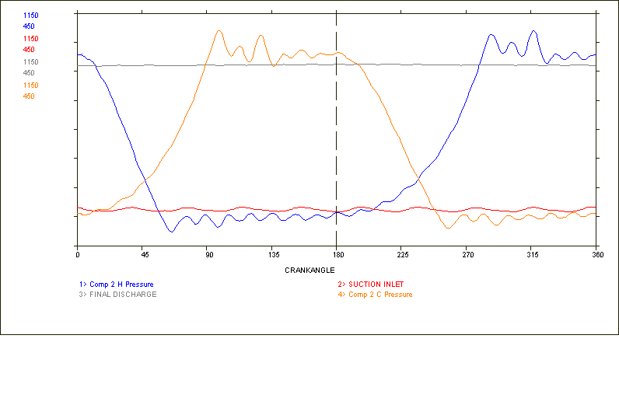
Cylinder Pressure With Suction & Discharge Line Overlay

Slide 65
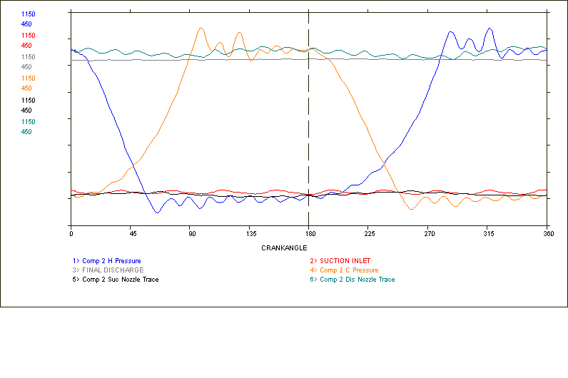
With Nozzle Traces Added

Slide 66
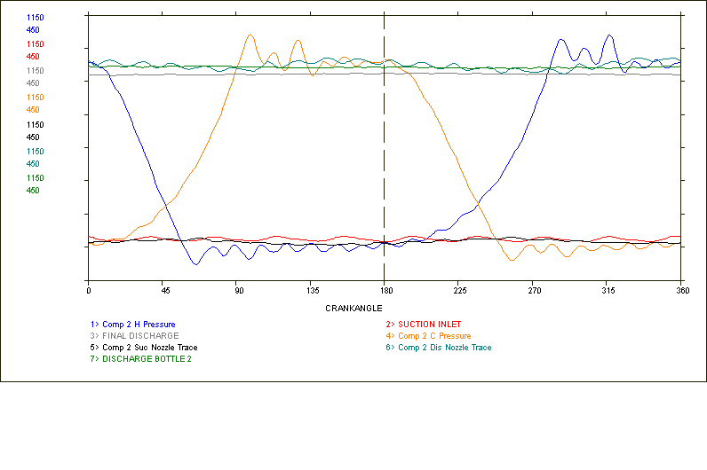
With Discharge Bottle Trace Added

Slide 67
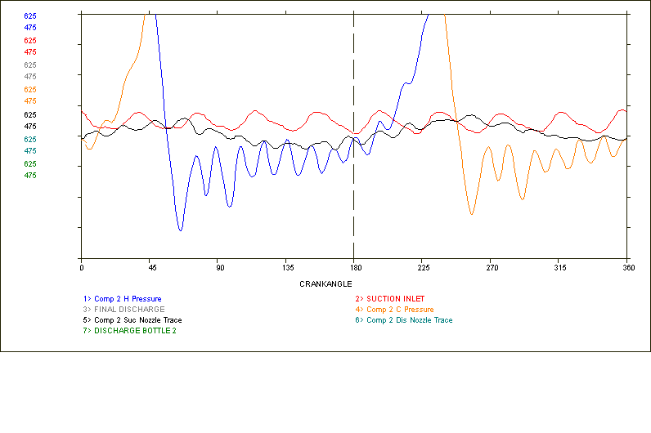
Expanded Suction Events

Slide 68
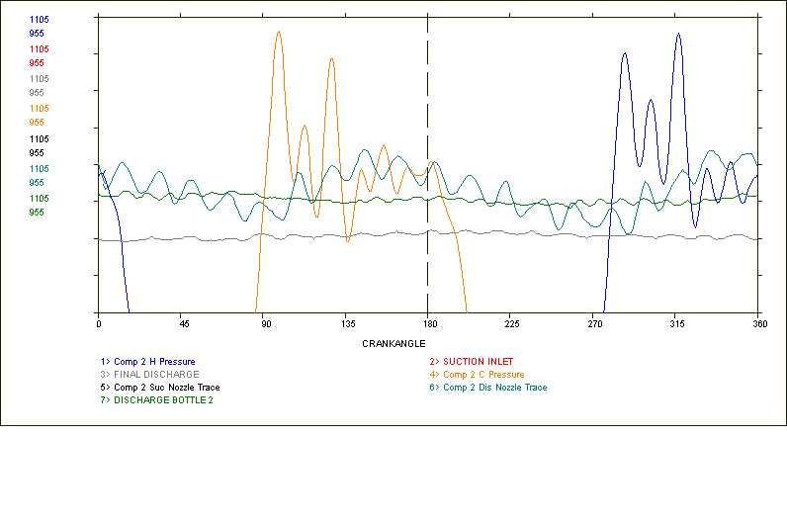
Expanded Discharge Events

Slide 69
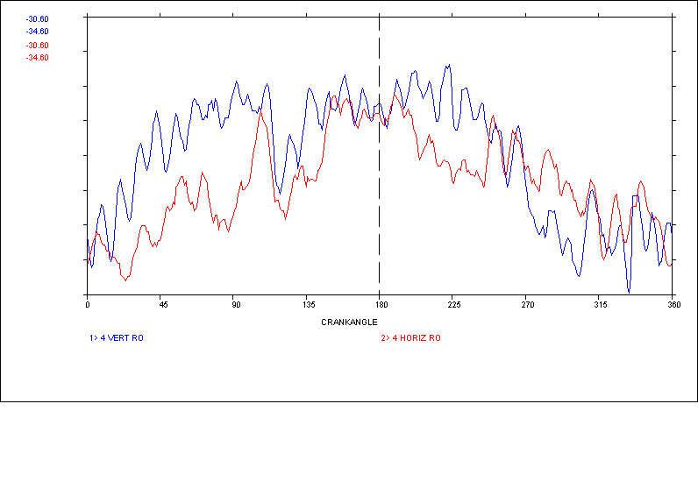
Rod Runout
vertical
horizontal
2 . 5 mils

Slide 70
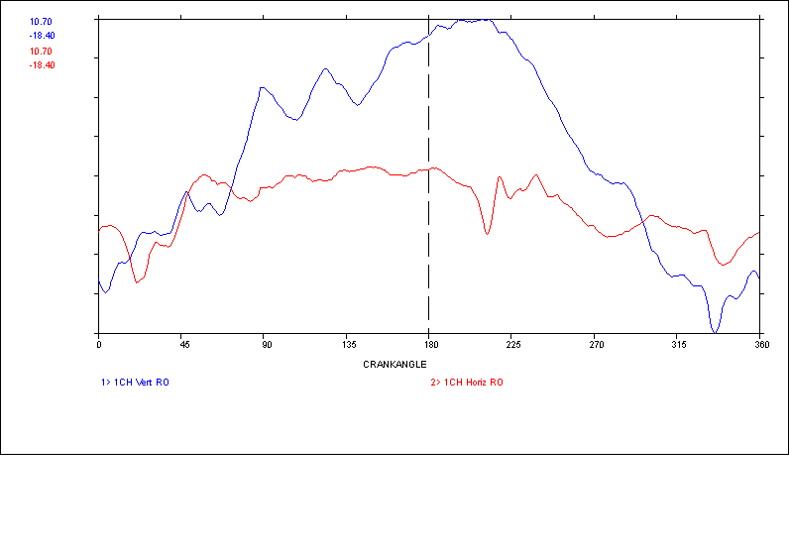
Excessive Compressor Rod Dynamic Run-out
vertical
Horizontal
25 mils
Piston centerline lower than cross-head centerline
In this plot, the vertical probe is mounted on top of the rod and is measuring the gap

Slide 71
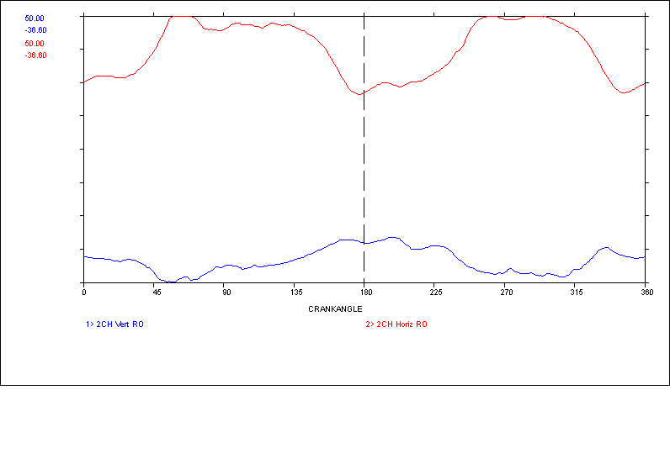
Compressor Rod Dynamic Runout
Rod moving away from probe
Piston and liner wear
20 mils

Slide 72
Rod Load
The piston rod is alternatively under compression and tension, and being of a relatively narrow cross-section, is subject to high mechanical loads and high cyclic fatigue stresses.
The gas rod load is the force in pounds applied to the reciprocating parts due to internal cylinder pressure and area differentials across the piston ends.
Some manufactures may include the effect of inertia forces of the crosshead and piston assemblies in their load limits.

Slide 73
Crosshead Pin Load
The net load on the crosshead pin and bushing is comprised of inertia (component mass and speed) and static (gas load) forces
In most applications the net load is required to be reversing at the crosshead pin and bushing (changes from compression to tension and back to compression in one revolution of the crankshaft)

Slide 74
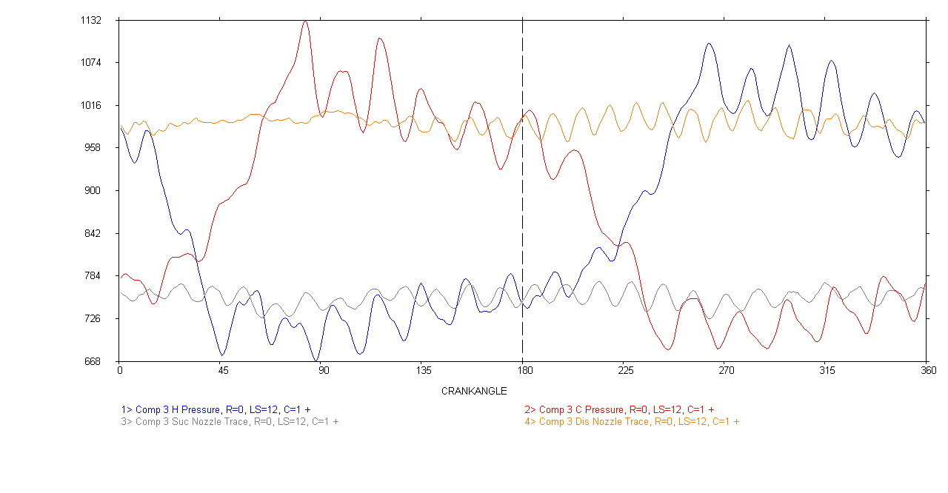
Channel Resonance Must be Corrected before Rod Load Measurements

Slide 75
Channel Resonance Correction
Smoothing is a method of correcting the collected pressure data for inherent indicator passage resonance
This resonance does not significantly affect the horsepower measurement because it is sinusoidal in nature
If this resonance is present during the compression and re-expansion portions of the pressure trace, it can significantly affect the accuracy of the Toe pressure and Volumetric Efficiency picks
This resonance can also cause measured peak differential pressures to be higher than actual

Slide 76
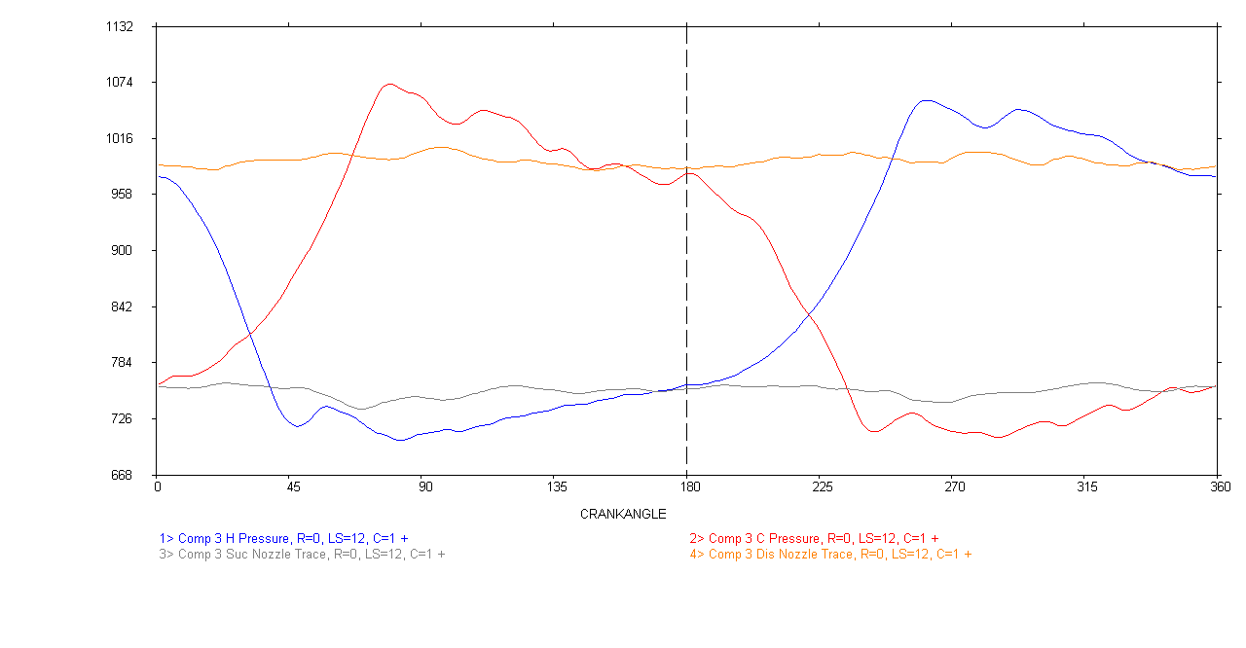
Resonance Corrected

Slide 77
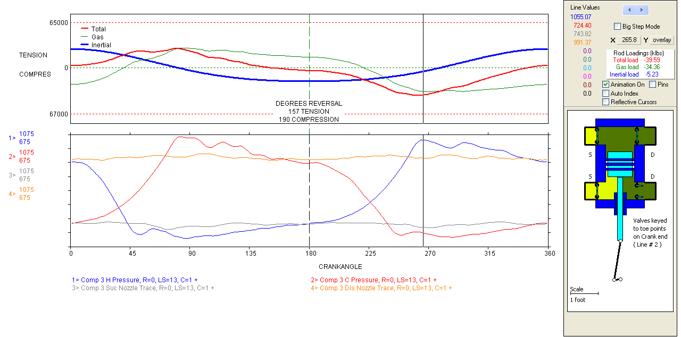
Corrected Rod Load Plot

Slide 78
Static or Gas Load
Static or gas load is the force on the cylinder reciprocating components resulting from the gas pressure applied to the surface area of the piston faces
Analyzers calculate and plot the results for each degree of crankshaft rotation
Gas forces alone may or may not cause a force reversal at the crosshead pin and bushing

Slide 79
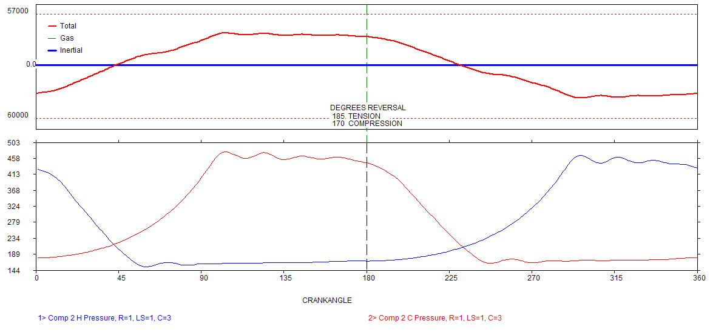
Static Gas Load
tension
compression

Slide 80
Inertia Load
Inertia load is the force on the cylinder reciprocating components resulting from the change in their velocity
Analyzers calculate and plot the results for each degree of crankshaft rotation
Inertia forces are always reversing on every revolution of the crankshaft

Slide 81
Crank Mechanism
Reciprocating inertia forces are caused by the acceleration and deceleration of the reciprocating masses
26

Slide 82
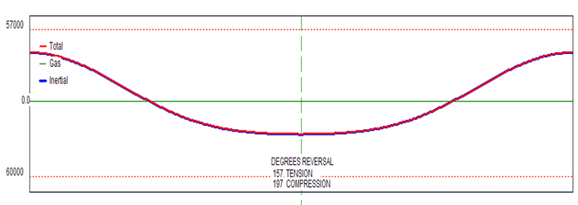
Inertia Loading
Tension load
Compression load

Slide 83
Net Load
Is simply the sum of the inertia and gas load forces
Is calculated for each degree of crankshaft rotation
Reversal occurs after the net rod load passes through 0 pounds and has met the Mfg requirements for a reversal

Slide 84
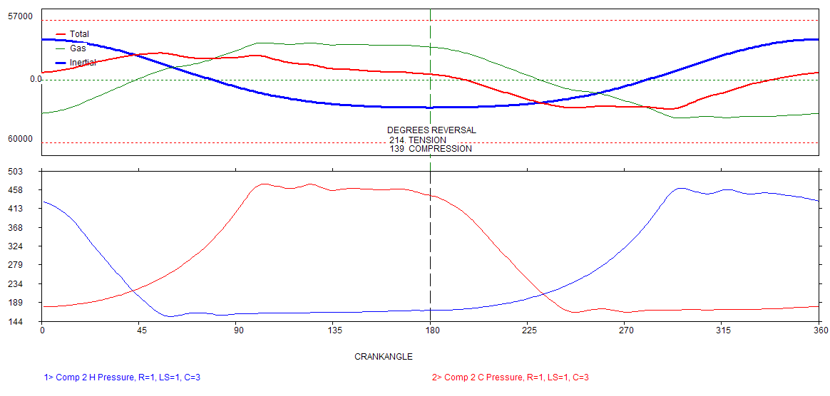
Net Load
tension
compression
139 deg

Slide 85
Ariel Rod Load Method
CRL = (HE area x Pd) - (CE area x Ps)
TRL = (CE area x Pd) - (HE area x Ps)
Ps=average pressure during suction event
Pd=average pressure during discharge event
Pressures are gauge

Slide 86
Dresser-Rand Rod Load Method
CRL=(HE area x Pd) - (CE area x Ps) + Inertia
TRL=(CE area x Pd) – (HE area x Ps) + Inertia
Ps = internal suction pressure @ max internal differential across piston area
Pd = internal discharge pressure @ max internal differential across piston area
Inertia calculated from all reciprocating mass except connecting rod

Slide 87
GE Oil & Gas Rod Load Method
CRL= (HE area x Pd) - (CE area x Ps) + Inertia
TRL = (CE area x Pd) - (HE area x Ps) + Inertia
Ps=internal suction pressure @ max internal differential across piston area
Pd=internal discharge pressure @ max internal differential across piston area
Inertia calculated from all reciprocating mass except connecting rod

Slide 88
Superior Rod Load Method
CRL = (HE area x Pd) - (CE area x Ps) + Inertia
TRL = (CE area x Pd) - (HE area x Ps) + Inertia
Ps=internal suction pressure @ max internal differential across piston area
Pd=internal discharge pressure @ max internal differential across piston area
Inertia calculated from all reciprocating mass except connecting rod

Slide 89
Ajax Rod Load Method
CRL = (HE area x Pdt) - (CE area x Pst)
TRL = (CE area x Pdt) - (HE area x pst)
Pst=internal suction toe pressure
Pdt=internal discharge toe pressure
Pressures are psig

Slide 90
Rod Reversal
Rod reversal occurs when the combination of pressure and inertia forces on the reciprocating components cause a reversal in the loading of the crosshead pin and bushing
This is sometimes referred to as load reversal

Slide 91
Rod - Load Reversal
Is generally required at the crosshead pin and bushing for adequate lubrication
Without reversal (non-reversal), oil is not applied to the load bearing side of the pin and bushing

Slide 92
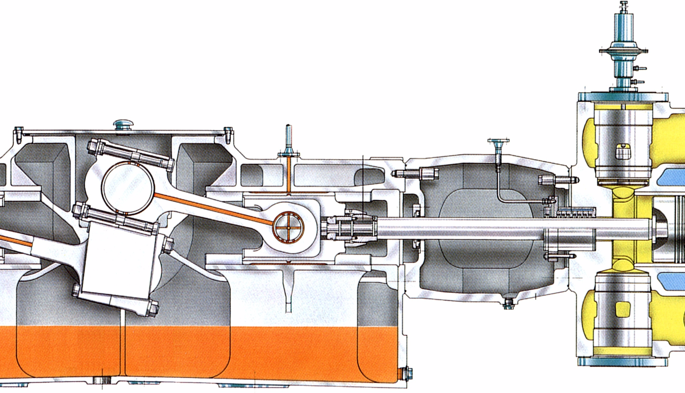
Crank mechanism - rod forces and reversals
crankshaft
big-end bearing
crosshead
connecting rod
crosshead guide
crosshead bearing
main bearing
crosshead connecting pin
crankcase
small-end bearing

Slide 93
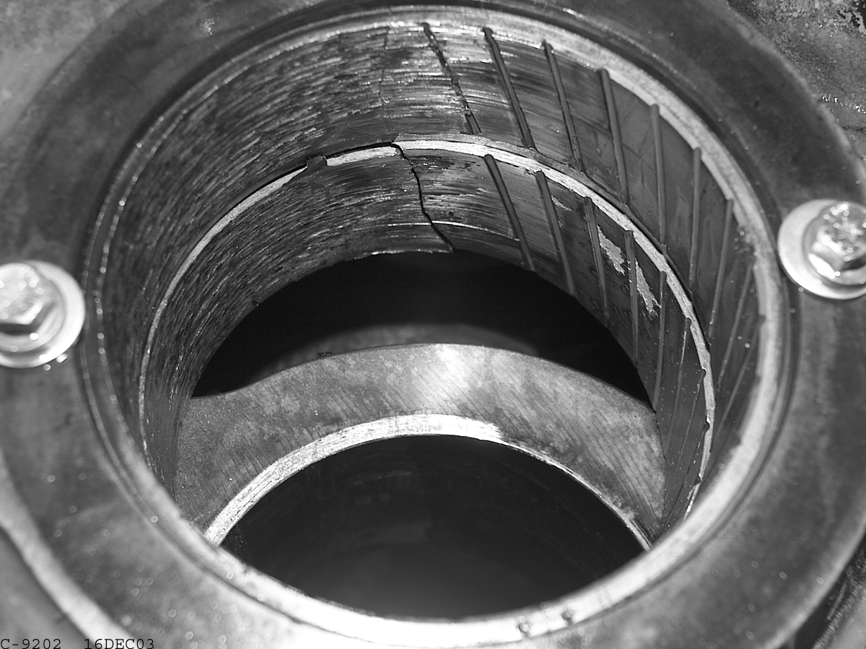
Lubrication Failure (Bushing)

Slide 94
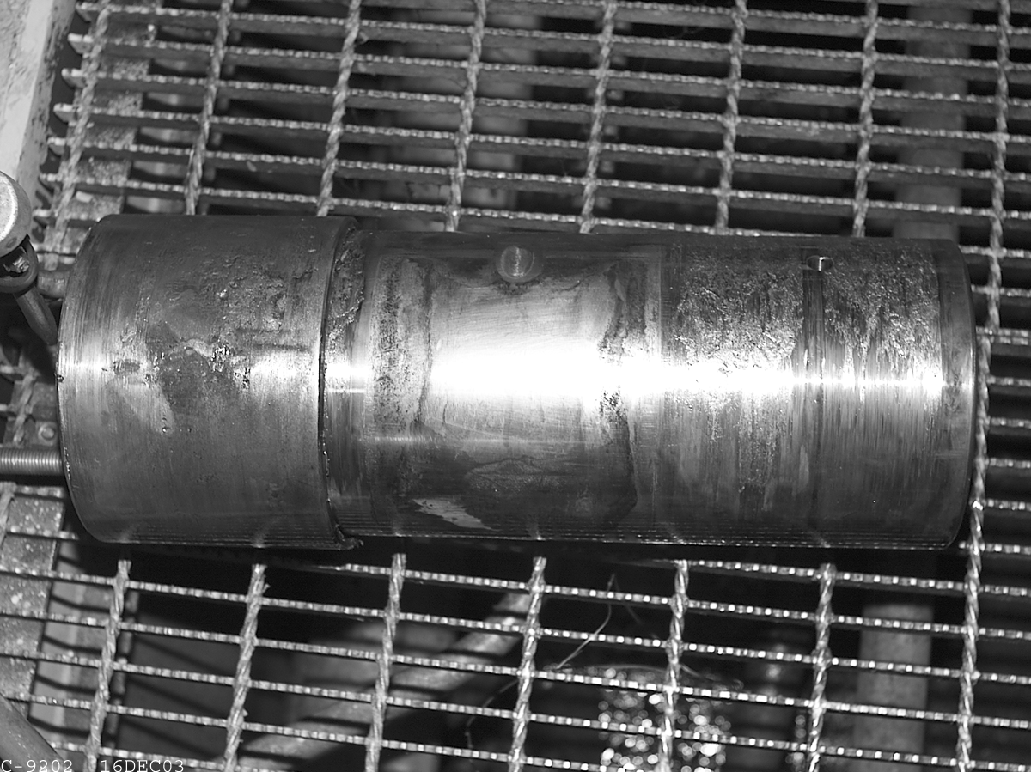
Lubrication Failure (Pin)

Slide 95
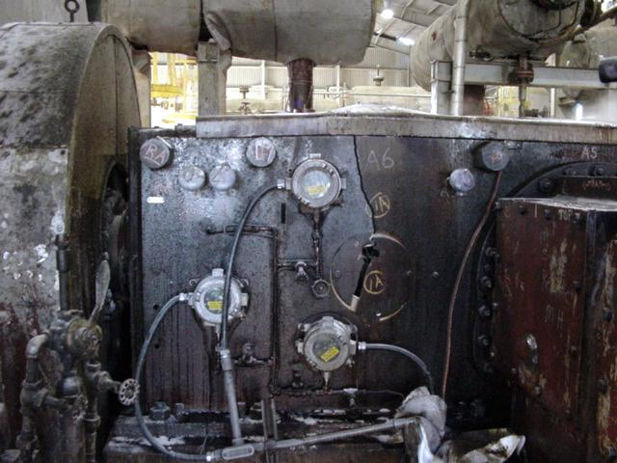
Frame Failure
©Copyright 2003, Dresser-Rand Company. All Rights Reserved

Slide 96
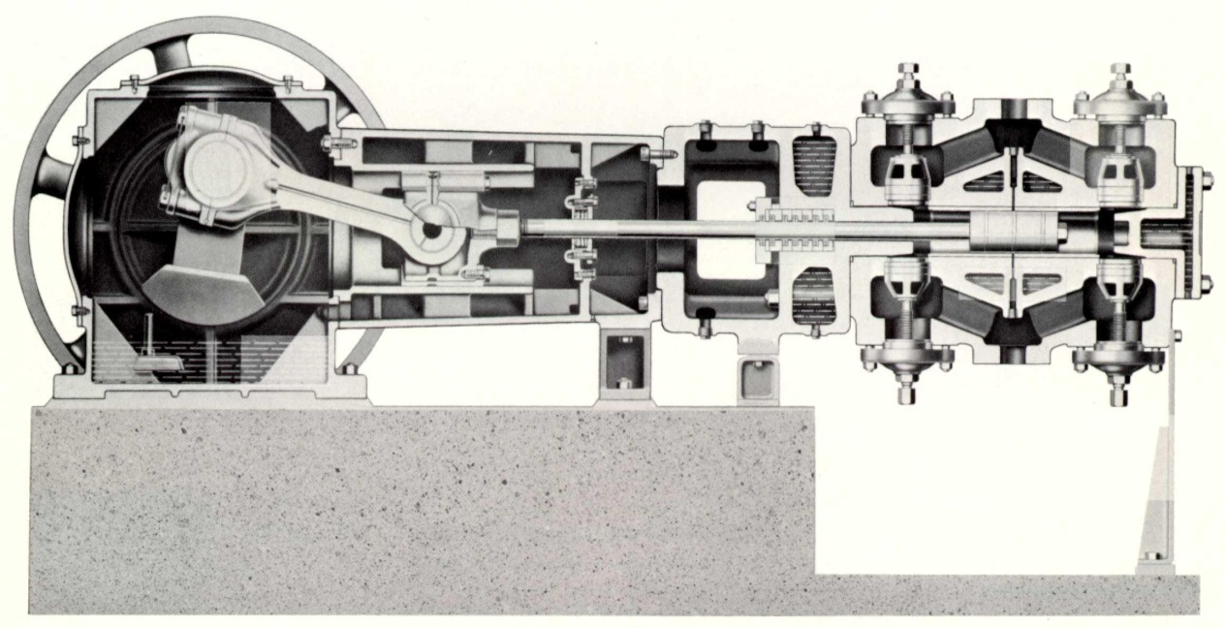
Mechanical Specifications and Dimensions Required for Inertia Load Measurement
Connecting Rod Length
Stroke
Mass of Reciprocating components
Crank Phase

Slide 97
Reciprocating Mass Combinations
For force at the piston to rod connection
Piston Weight
For force at the rod in front of crosshead
Piston and rod assembly weight
For force at the piston rod to crosshead connection
Piston, piston rod and jam nut weight

Slide 98
Reciprocating Mass Combinations
For force at the cross-head pin and bushing (rod reversal measurement)
All reciprocating weight excluding any portion of the connecting rod
For pin fixed to crosshead, include pin weight
For pin fixed to connecting rod, do not include pin weight
For full floating pin, consult the manufacturer or split the weight

Slide 99
Design Requirements API 618
The rod loads shall be calculated based on the internal pressure during discharge stroke (including ventilation losses) and shall not exceed the manufacturers maximum allowable load at any specified operating load step
The duration of the rod load reversal shall be 15° rotation angle minimum. The magnitude of peak shall be 3% minimum of the opposite peak.
Simple bushing designs (un-grooved) may require a minimum of 45 ° of rod reversal and a 20% magnitude.
Individual Manufacture’s Requirements May Vary
99

Slide 100
Rod Reversal Requirements
Ariel: minimum of 30 degrees and 25% opposite force
Ajax: minimum of 30 degrees and 3% opposite force
Dresser-Rand: minimum of 30 degrees and X% opposite force (suggest 3%)
GE Oil & Gas: minimum of 60 degrees and 15% opposite force
Superior: minimum of X degrees and X% opposite force (suggest 30 degrees and 15%)

Slide 101
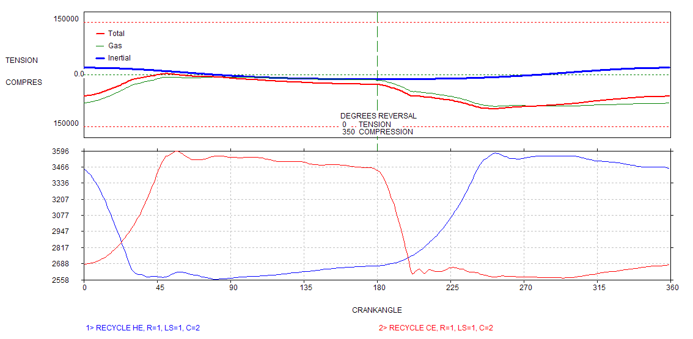
No reversal
Low ratio, small bore, large diameter piston rod

Slide 102
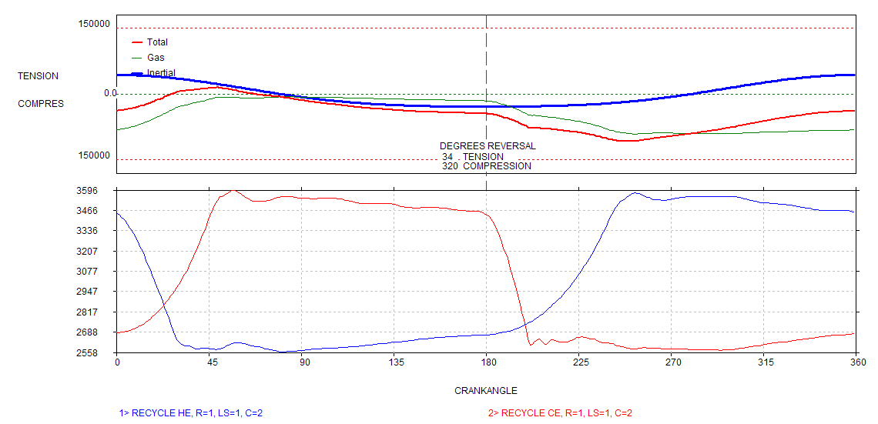
Extra Mass Created Reversal

Slide 103
Single Acting Cylinders
Net rod loads for single acting cylinders are determined by the same procedure as for double acting cylinders
Cylinder ends are usually unloaded at suction pressure or, in some cases, discharge pressure
Load reversals are generally shorter and smaller in magnitude

Slide 104
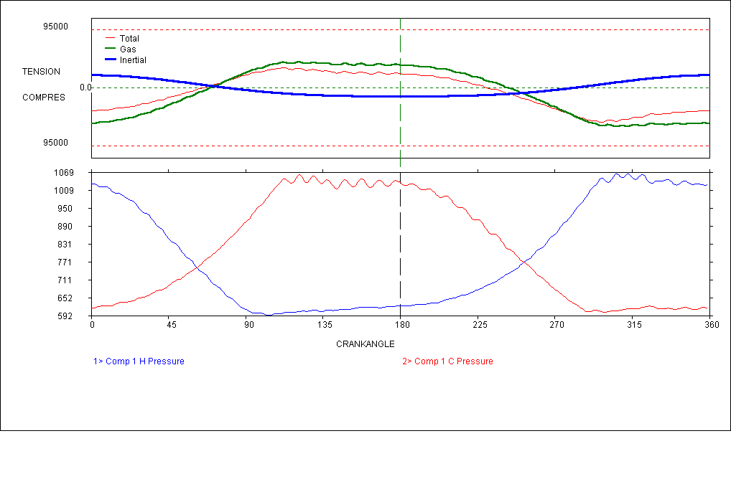
Double Acting Cylinder
reversal
Good reversal with both ends loaded
12.5” bore, 4.0” rod, 750 lb reciprocating mass

Slide 105
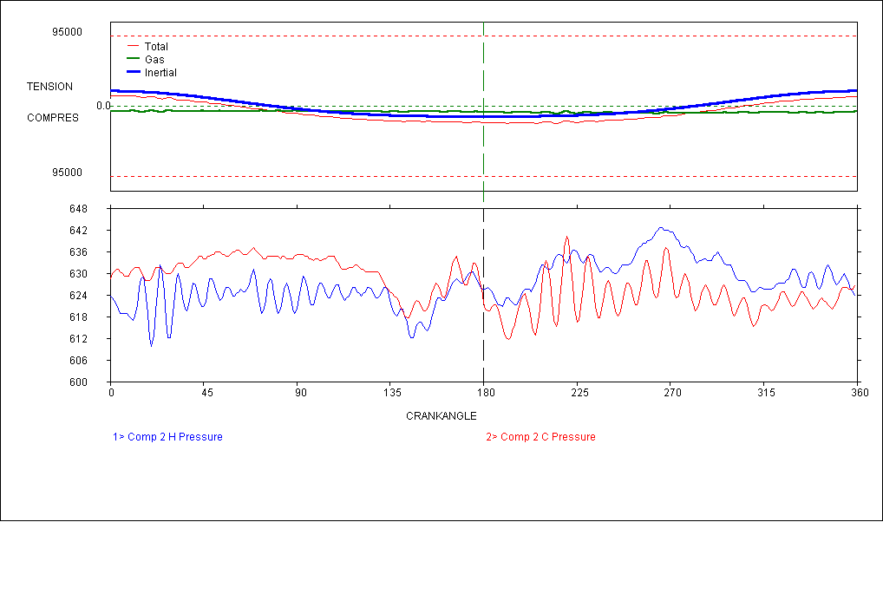
Cylinder Ends Both Deactivated
reversal
The effect of unloading both ends at suction pressure
12.5” bore, 4.0” rod, 750 lb reciprocating mass

Slide 106
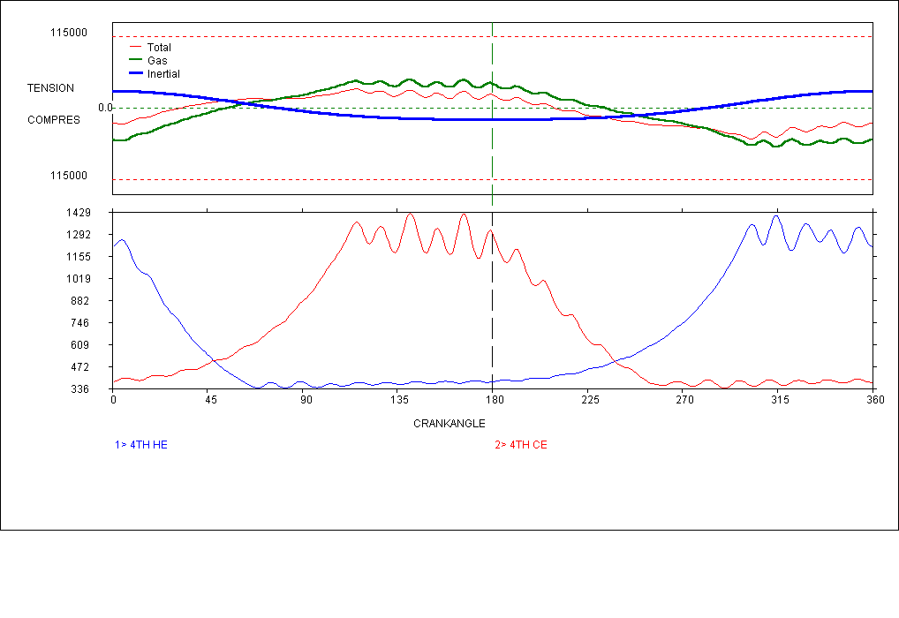
Double Acting Cylinder
reversal
Normal double acting operation
8.5” bore, 3.5” rod, 1000 lb reciprocating mass

Slide 107
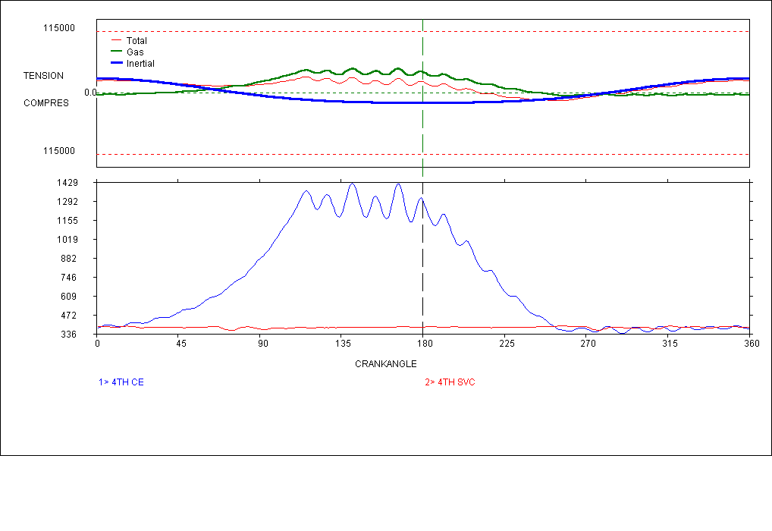
Single Acting Crank-end Cylinder
reversal
Head-end unloaded at suction pressure
8.5” bore, 3.5” rod, 1000 lb reciprocating mass

Slide 108
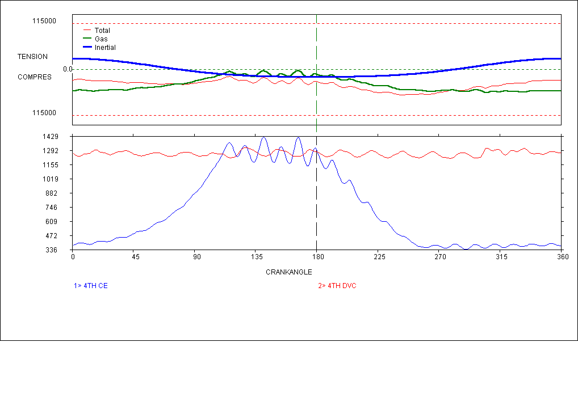
Single Acting Crank-end Cylinder
No reversal
Head-end unloaded at discharge pressure
8.5” bore, 3.5” rod, 1000 lb reciprocating mass

Slide 109
Single Acting Head-end Cylinder
Insufficient reversal
Does not meet opposite force requirement
Crank-end unloaded at suction pressure
8.5” bore, 3.5” rod, 1000 lb reciprocating mass

Slide 110
Factors that May Increase Non-reversal Condition
Single acting head end (crank-end unloaded) is more susceptible to non-reversals
With steady conditions, reduced speed may contribute to non-reversal (reduced inertia)
Small bore sizes with large compressor rods may approach single acting conditions (tail rod may be necessary)

Slide 111
Dynamic Reversals Can Aid in Looseness Diagnosis
E.g. Impacts occur close to the dynamic reversals when all reciprocating weights (except con rod) are used to calculate inertia. XH pin and bushing knock indicated

Slide 112
Compressor Cylinder # 4
Crosshead vib
Phased to Cylinder

Slide 113
Seized XH Pin and Bushing

Slide 114
Reciprocating Component Weights JGE-4 (6.375 diameter Piston)
Con Rod: 94 #
X-Head: 75 #
Piston & Rod: 71 #
Nut: 10 #
Balance weight: 49 #
Total: 299 #
Piston & Rod + Nut & Weight = 130 #
From Manufacture’s data

Slide 115
Loose Crosshead Jam Nut
Inertia based on 130 # mass
Force reversals

Slide 116
Piston Loose on Rod
Two impacts per revolution
Impacts occur very close to the dynamic reversal when only the piston weight is used to calculate inertia
Pressed fit piston on rod may move both impacts to the right
Loose piston on tapered rod may have one minor impact near force reversal and the other on the crank-end compression rise

Slide 117
Compressor Rod Loose at XH
Two impacts per revolution
Impacts occur very close to the dynamic reversal when the piston, rod jam nut and rod weight are used to calculate inertia

Slide 118
XH Pin and Bushing Wear
Two impacts per revolution
Impacts occur very close to, or slightly to the right of, the dynamic reversal when the piston, rod, jam nut, balance weights and cross-head weight are used to calculate inertia

Slide 119
Rod Wear

Slide 120
Typical Compressor Leakage
High Pressure Gas Out
Internal
High Pressure Gas In

Slide 121
Leakage Characteristics
A leakage can only occur from a high pressure to a low pressure.
A valve only leaks when it is closed.
If a valve ultrasonic pattern is noisier when the valve is closed than when the valve is open, it is probably leaking.
Head end suction leakage can be very similar to crank end discharge valve leakage.
Crank end suction leakage can be very similar to head end discharge valve leakage.
Be careful with crosstalk from head end to crank end.

Slide 122
Compressor HE Valve Leakage
Discharge leakage area
Suction leakage area

Slide 123
5S
6S
4S
HE
3D
2D
1D

Slide 124
5S
6S
4S
HE
3D
2D
1D

Slide 125
1S
2S
HE
4D
3D

Slide 127
VED VES DL SL FB DP SP CR T2 T1 TRL CRL

Slide 129
Compressor CE Valve Leakage
Discharge leakage area
Suction leakage area

Slide 130
5S
6S
4S
CE
3D
2D
1D

Slide 131
2S
3S
1S
CE
6D
5D
4D

Slide 132
1S
2S
CE
2D
1D

Slide 146
Before Testing
Verify pressure transducer performance.
Research the maintenance history of the unit.
Review previous analysis reports.
Verify TDC reference accuracy.
Inspect indicator valves and passages.
Talk to people closely associated with the unit about potential problems.

Slide 147
Initial Site Inspection
Visual indicators of load
Packing vent emissions
By-pass, vent, blow-down, relief and recycle valve leakage
Pad, base, line, vessel and accessory vibration

Slide 148
Initial Site Inspection
Ultrasonic survey of external leaks (head gaskets, valve caps, pockets, unloaders, flanges, packing glands and rod packing, pneumatic control lines and actuators)
Ultrasonic Leak Survey

Slide 149
Initial Compressor Visual Inspection
Temperature of valve caps, packing vents, capacity control devices, recycle and vent valves
Feel and listen for knocks to identify potential problems.
Gather all manual panel, temperature and IR sensor test point data if dynamic pressure data is to be collected next.

Slide 150
Compressor End Manual Panel Points
Suction reference pressure per stage
Discharge reference pressure per stage
Pocket position per cylinder end (load step)
Predicted or measured flow rate
Predicted BHP/torque
Pump and bearing oil pressure (separable units)

Slide 151
Compressor Manual/IR Temp. Points
Suction reference temperature
Discharge reference temperature
Valve cap temperatures
Packing vent temperature
Cooling water in and out temperatures
Oil in and out (separable units)
Scavenge/air cylinder suction and discharge temperatures

Slide 152
Compressor Sensor Points
Head and crank end dynamic DC pressure
Suction and discharge pressure overlays (optional)
Head end high frequency and raw vibration
Cross-head raw and high frequency vibration
Valve cap ultrasonic and/or high frequency vibration
Closed clearance pocket ultrasonic
Dynamic rod run-out (optional)
Scavenge cylinder suction and discharge ultrasonic
Scavenge cylinder high, low and raw frequency vibration
Compressor frame main bearing raw & high frequency vibration (for separable frames)

Slide 153
Compressor End Analysis
Collect all manual panel, manual temp and infrared data just prior to or just after collecting dynamic pressure information
Gather all sensor point information while holding the unit load as constant as possible
Perform “dynamic” troubleshooting (unloaders & pockets) using auto-scan features
View manual and performance reports to determine if collected data is in memory and if additional data collection or troubleshooting is required

Slide 154
Analyzer Equipment Setup (Encoder)
Crank-angle Encoder
Mechanical or friction drive
No slippage
Shaft properly aligned
Solid on floor
Avoid excessive tension
Angular velocity issues

Slide 155
Analyzer Equipment Setup (Once Per Turn/n-turn)
Magnetic Pickup
Magnetic or optical pickup
Not tracking crankshaft by degree
Works better on electric driven compressors
No angular velocity data

Slide 156
(TDC Identification and Synchronization)
TDC Marks (accuracy rules!)
Reference mark on flywheel lined up with reference mark on frame
Couplings can cause synchronization errors on separable machines
Second stationary mark on frame eliminates parallax errors

Slide 157
TDC Accuracy
Shifting the data 2 degrees to the right on a KVS-48 in injection service caused:
Power IHP to increase by 7%
Compressor IHP to decrease by 8.6%
Shifting the data 2 degrees to the right on a low ratio pipeline compressor service caused:
Compressor IHP to decrease by 4.2%
The lower the VE, the greater the induced error.

Slide 158
TDC Determination
Cylinder obstruction method
Dial indicator method
Existing factory marks
Determining from collected data
Guess

Slide 159
Verifying/Marking TDC (Positive Stop Method)
No dial indicator is required; however the cylinder head or valve cap must be removed so the unit must be blown down.
The basis of this method is that TDC can be determined from the midpoint of two cylinder positions marked on the flywheel. These positions are determined by the placement of the cylinder at a fixed distance from TDC. This fixed distance is determined by the hard stop used.
The first step in this process is to obtain the hard stop. The stop can be inserted into the cylinder by removing the valve cap or the cylinder head. If the cylinder head is removed, obtain a stiff 1/4-inch rod and sharpen one end to form a pointer. The length of the rod should be set, such that the piston stops at 2 to 10 degrees below TDC.

Slide 160
Verifying/Marking TDC (Positive Stop Method)
Attach pointer to a rigid strip of steel and drill appropriate mounting holes in it. The strip must not deflect when the piston contacts it. The strip is placed across the center of the cylinder bore and bolted to secure it. If a valve cap is removed, place the stop between the head and piston.
Once the positive stop mechanism is installed, manually rotate the crankshaft in the clockwise direction until the piston end comes in contact with the stop. Mark this position on the flywheel in reference to a fixed pointer.
Rotate the crankshaft in the opposite direction until the piston end comes in contact with the stop. Mark this position on the flywheel. Using a highly accurate measurement device, determine the middle between the two marks. This is the location of TDC (+/- ½ degree accuracy required).

Slide 161
Verifying/Marking TDC (Dial Indicator Method)
Rotate the compressor crankshaft till the reference cylinder is approximately at ODC.
Install a dial indicator to measure crosshead movement.
Position the dial indicator, such that the indicator is touching the crosshead or crosshead shoe.
Rotate the compressor until the piston is near TDC (the dial indicator will stop moving). Zero the dial indicator.
Rotate the crankshaft in the opposite direction until it reaches 0.030”. Rotate the crankshaft back in the other direction until the dial indicator reads 0.015”. Mark this location on the flywheel in reference to a fixed pointer.

Slide 162
Verifying/Marking TDC (Dial Indicator Method)
Rotate the crankshaft in the same direction until the dial indicator reads 0.030” (the compressor will progress through TDC and past it, so the dial indicator will read 0 and then go back to 0.030”).
Rotate the crankshaft back the other direction until the dial indicator reads 0.015”. Mark this location on the flywheel in reference to the same fixed pointer used above.
Using an accurate distance measurement, mark the center between these two marks on the flywheel. This is the location of TDC (+/- ½ degree accuracy required).
Rotate the crankshaft back to the marks made (using the procedure above) and check the locations of the marks. If the locations are repeatable, then the TDC marking is satisfactory.

Slide 163
On-Machine Analysis
Analysis done at the machine
Using all the capabilities of the Analyzer while at the machine (Calculate, Zoom)
Observing the Temperatures and Operating parameters
Analyzing real-time Pressure, Vibration and Ultrasonic data in the Auto-Scan Mode
Viewing the reports and plots for data confirmation and integrity
Knowing about 80% of the information that will be reported before leaving the compressor

Slide 164
What You Should Know From the Compressor Test
Determine the mechanical condition of each compressor valve
Identify flow restrictions or excessive pressure drops
Find leaking rings
Detect loose piston on the rod
Determine if the pockets are leaking
Evaluate the effectiveness of the capacity control and unloader devices
Locate external process leaks including packing
Survey the bearings, pins and bushings for extra clearance
Measure the HP, capacity and efficiency of each cylinder
Determine the effective operating clearance volume
Other vibration related problems (looseness, alignment, etc.)

Slide 165
Reports
Compressor Performance
Manual Panel, Temperature/IR
Economic
Set-up Data
Prioritized Deficiency List

Slide 166
Compressor Performance Report
Without an accurate TDC, the report has limited value

Slide 167
Compressor Performance Report
Capacity is the average of the calculated flow rate at both suction and discharge conditions. This number is a good indicator of the actual capacity only when the cylinder is healthy and all collected data is accurate
IHP accuracy is not dependent on the cylinder health; however, the geometry, TDC accuracy, and sensor linearity must be accurate.
IHP/MMSCFD is
IHP/calculated average capacity

Slide 168
Compressor Performance Report
These items are used in the flow calculation at suction conditions. All 3 can be affected by the mechanical condition of the cylinder. Even in a healthy cylinder, the values could be wrong. The temperature at the cylinder valve port is difficult to obtain. The pressure and volumetric efficiency accuracy can be affected by channel resonance. The pressure can be affected by the sensor zero and linearity.

Slide 169
Compressor Performance Report
Absolute compression ratio
These items are used in the flow calculation at discharge conditions. All 3 can be affected by the mechanical condition of the cylinder. Even in a healthy cylinder, the values could be wrong. The temperature at the cylinder valve port is difficult to obtain. The pressure and volumetric efficiency accuracy can be affected by channel resonance. The pressure can be affected by the sensor zero and linearity.

Slide 170
Compressor Performance Report
The minimum reversals in degrees are calculated using both the gas load and inertia loading. The mass in the setup data should include all reciprocating mass except the connecting rod weight. A “T” indicates that the minimum reversal occurs in tension.
These are the % of the rod load limits in the setup file and are calculated from gas loads only. Any values close to 100 would require viewing of the actual rod load plots.

Slide 171
Compressor Performance Report
These are the minimum calculated capacities for each stage. They should have a reasonable agreement for the same product stream. The calculated capacities have a tendency to increase when there are internal cylinder leakages, while the actual capacities are diminishing.
These values are extremely dependent on the TDC accuracy.

Slide 172
Compressor Performance Report
calculated
Measured (from page 1)
The Theoretical discharge temperature is calculated from the measured suction temperature, the compression ratio of the toes and the K-value of the gas.
difference
The delta temperature will elevate as the cylinder leakage rates increase.

Slide 173
Compressor Performance Report
In a healthy cyl end, the SWR calculation will normally agree closely with the set clearance if the set clearance is an accurate value.
calculated
difference
The Set value is used in the creation of the theoretical PV models, the log/log plots, and the polytropic values (n). It must represent the actual clearances in the individual cylinders ends.
These are the calculated clearances using the GPSA method. The actual clearance is not needed to make this calculation. The avg value should be used as the set clearance for good diagnostic plots of theoreticals. In a healthy cylinder, with an accurate TDC, the Suc and Dis calculations will be close together.

Slide 174
Compressor Performance Report
These values are calculated from the supplied gas analysis information.

Slide 175
Compressor Performance Report
If accurate gas data is available and the cylinder end is healthy, the Adiabatic K and the Polytropic N values will be very close.
The N ratio is
N Exp / N comp and is comparable to flow balance when all data is accurate.
These N values are calculated from the slope of the compression and re-expansion lines and generally agree with each other in a healthy cylinder. Accurate clearance data is required.

Slide 176
Compressor Performance Report
The theoretical IHP and efficiency are determined by comparing the measured IHP to the theoretical HP.
These are the calculated capacities at suction and discharge conditions. Their accuracy is dependent on the health of the cylinder and the accuracy of the collected data.

Slide 177
Calculated Capacity
Is only valid for a healthy cylinder
Suction calculated capacity goes up with a suction valve, packing or ring leak
Suction calculated capacity goes down with a discharge valve leak
Discharge calculated capacity goes up with a discharge valve leak
Discharge calculated capacity goes down with a suction valve leak or ring leak
The average of the calculated suction and discharge capacity goes up significantly with ring leakage and generally up slightly for valve and packing leakage

Slide 178
Flow Balance
Accurate flow balance is dependent on the accuracy of the TDC reference, toe pressures, suction and discharge temperatures at the valve ports, gas compressibility, and VE picks.
Flow balance by itself is not a reliable way to determine the health of the compressor cylinder.
Do not adjust the TDC offset in an effort to improve flow balance alone.

Slide 179
Now, let’s review

Slide 190
4 Valves per End
A Destroyed discharge valve
B Discharge valve in suction port
C Suction valve in discharge port
D Indicator passage drilled into discharge cavity
E None of the above

Slide 191
Double-Acting Cylinder with 4 Valves per End
A Excessive discharge valve leakage
B Wrong reported clearance
C Excessive suction valve leakage
D Rings leaking in one direction
E None of the above

Slide 192
Double-Acting Cylinder with 4 Valves per End
A Excessive discharge valve leakage
B Excessive suction valve leakage
C Excessive ring leakage
D All of the above
E None of the above

Slide 193
Double-Acting Cylinder with 4 Valves per End
A Discharge valve leakage in both ends
B Suction valve leakage in both ends
C Suction leakage in head end & discharge leakage in crank end
D Ring leakage
E None of the above

Slide 194
Double-Acting Cylinder with 4 Valves per End
A Head end discharge valve leakage
B Crank end suction valve leakage
C Moderate ring leakage
D Excessive power losses
E None of the above

Slide 195
Double-Acting Cylinder with 4 Valves per End
A Head end discharge valve flutter
B Crank end suction valve flutter
C Indicator passage channel resonance
D Ring leakage
E All of the above
F None of the above

Slide 196
Double-Acting Cylinder with 4 Valves per End
A Head end discharge valve flutter
B Crank end suction valve leakage
C Indicator passage
channel resonance
D Ring leakage
E All of the above
F None of the above

Slide 197
Double-Acting Cylinder with 4 Valves per End
A Head end suction valve leakage
B Crank end suction valve leakage
C Ring leakage
D None of the above

Slide 198
Double-Acting Cylinder with 4 Valves per End
A Slight crank end suction valve leakage
B Slight crank end discharge valve leakage
C Slight head end discharge valve leakage
D Ring leakage
E None of the above

Slide 199
Double-Acting Cylinder with 4 Valves per End
A Suction and discharge valve leakage
B Set clearance volume is smaller than actual
C Set clearance volume is larger than actual
D Ring leakage
E None of the above

Slide 200
6 Valves per End
A Head end suction valve leakage
B Head end discharge valve leakage
C Crank end suction valve leakage
D Crank end discharge valve leakage
E Ring leakage
F None of the above

Slide 201
Double-Acting Cylinder with 6 Valves per End
A Top valve indicates leakage
B Bottom valve indicates insufficient lift
C Middle valve indicates restriction
D Bottom valve indicates spring damage
E Both A and D
F Both A and C

Slide 202
2 Valves per End
A Top valve is a leaking suction valve
B Top valve is a leaking discharge valve
C Top valve is a suction valve with a sticking component
D Both A and C
E None of the above

Slide 203
Double-Acting Cylinder with 6 Valves per End
A Cylinder has slight discharge valve leakage
B Cylinder has moderate discharge valve leakage
C Cylinder has moderate suction valve leakage
D Cylinder has slight suction valve leakage
E Top two valve traces indicate leakage
F Both C and E

Slide 204
De-activated Head End Cylinder
A Loose piston on rod
B Piston hitting crank end head
C Piston hitting head end head
D None of the above

Slide 205
Atmospheric Pressure
The pressure of the atmosphere at your current location corrected to sea level.
True or False? ______

Slide 206
Standard Pressure
The pressure of the atmosphere at sea level and is the same for every company at all locations.
True or False? ______

Slide 207
Compression Temperature
Which of the following pure gases will get the hottest when compressed to an identical compression ratio?
Methane ______
Nitrogen ______

Slide 208
Packing Leakage
Packing leakage severe enough to show up in the PV trace looks similar to what other crank-end defect? Check all that apply.
Ring leakage ______
Suction valve leakage ______
Discharge valve leakage ______

Slide 209
Unloader Leakage
Finger or plug unloader leakage severe enough to show up in the PV trace looks similar to what other cylinder defect? Check all that apply.
Ring leakage ______
Suction valve leakage ______
Discharge valve leakage ______

Slide 210
Suction Valve Leakage
Suction valve leakage severe enough to show up in the PV trace has what characteristics? Check all that apply.
Flow balance less than 1 ______
Suction cavity significant temp increase ______
Discharge temperature increase ______
Discharge VE increase ______
Calculated suction flow rate increase ______
Discharge delta temperature increase ______

Slide 211
Discharge Valve Leakage
Discharge valve leakage severe enough to show up in the PV trace has what characteristics? Check all that apply.
Flow balance less than 1 ______
Suction cavity significant temp increase ______
Discharge temperature increase ______
Discharge VE increase ______
Calculated suction flow rate increase ______
Discharge delta temperature increase ______

Slide 212
Ring Leakage
Ring leakage severe enough to show up in the PV trace has what characteristics? Check all that apply.
Flow balance greater than 1 ______
Suction cavity significant temp increase ______
Discharge temperature increase ______
Calculated average flow rate increase ______
Discharge delta temperature increase ______

Slide 213
TDC Offset
Shifting the pressure trace to the right will result in ? Check all that apply.
Lower compressor IHP ______
Lower power cylinder IHP ______
A rise in the apparent mech engine eff% ______
Higher calculated average flow rate ______

Slide 214
IHP Measurement
Which of the following have an effect on the IHP measurement? Check all that apply.
Bore ______
Stroke ______
Connecting Rod length ______
K-value ______
Compressibility ______
Measured RPM ______
Transducer 0 offset ______
Transducer linearity ______

Slide 215
Flow Measurement
Which of the following have an effect on the calculated flow rate? Check all that apply.
Bore ______
Stroke ______
Connecting Rod length ______
K-value ______
Compressibility ______
Measured RPM ______
Transducer 0 offset ______
Transducer linearity ______

Slide 216
The following information is required to properly determine minimum rod reversal degrees: Check all that apply.
Bore _________
Stroke _________
Rod diameter _________
Connecting Rod length _________
RPM _________
Mass of piston assembly _________
Mass of crosshead assembly _________
1/3 of connecting rod weight _________
Gas specific gravity _________
Pressure per degree _________

Slide 217
The following information is required to properly determine the compressor reciprocating inertial forces at the crosshead pin and bushing: Check all that apply.
Bore _________
Stroke _________
Rod diameter _________
Connecting Rod length _________
RPM _________
Mass of piston assembly _________
Mass of crosshead assembly _________
1/3 of connecting rod weight _________
Gas specific gravity _________
Pressure per degree _________

Slide 218
The following information is required to properly determine compressor gas load forces: Check all that apply.
Bore _________
Stroke _________
Rod diameter _________
Connecting Rod length _________
Speed _________
Mass of piston assembly _________
Mass of crosshead assembly _________
1/3 of connecting rod weight _________
Gas specific gravity _________
Pressure per degree _________

