Slide 1


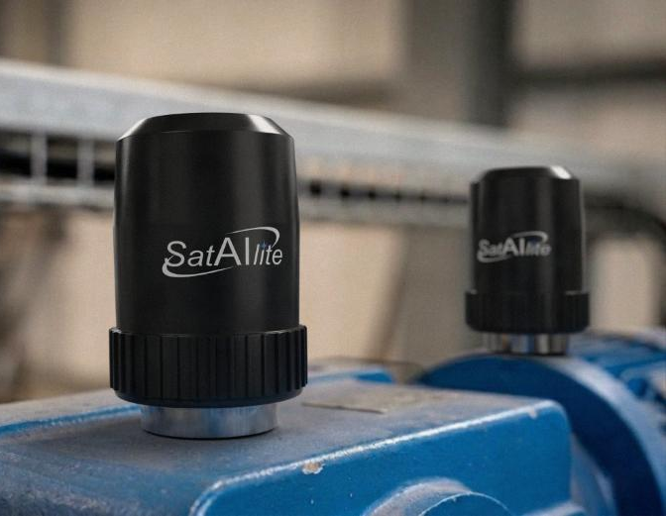
Data Sheet
SatAIlite smart sensors, the future of wireless sensing. Constantly powered by RF energy allows us to eliminate batteries and still provide continuous scanning and measurement of dynamic signals. SatAIlite accelerometers are smart Triaxial devices that constantly measure waveforms, compare them to alarm levels and transmit an FFT upon exception. Overall levels below alarm limits are transmitted at User specified timeframes based on User data storage requirements and charging time.
Data transmission range is up to a 1.6 km in open air. Actual range is installation dependent. Charging time and distance is based on location of our small Power Beacons that can be easily installed where needed.
Wireless, Battery-Free
Continuous Monitoring
This system incorporates wireless,
battery-free sensors with a Base
Station and Charge Beacon. Base
Station constantly communicates
with the SatAIlite sensors. Base-
Stations are intelligent EDGE
devices which process data in
real-time while communicating
with the client server and/or MMS cloud analytics software. The customizable features of the Sensor, Base Station and Power Beacons provide flexibility to deploy systems for difficult environments.
PATENTS
PENDING
Machinery Monitoring Systems, LLC ·· 10421 Lexington Drive, Suite D·· Knoxville, TN 37932

Slide 2
Data Sheet
Sensor | Specification
Sensor ID | Factory Set, Unique Number
Battery | N/A
Transmission Range | 1.6 km (Open Air)
Transmission Interval | Programable, Based on RF Strength
Certifications | FCC, IC, ANATEL
Hazardous Area Certification | UL, Ex, Class I Div. I. II (A-D) ATEX Zones 0-1 Installation dependent
Temperature | 275F/135C
Frequency Response | 15 KHz
Measurement Range | +/- 50g
Transmission Frequency (Unlimited) | Distance from Charge Beacon (Open Air)
1 Minute | 30 Meters
10 Minutes | 40 Meters
15 Minutes | 50 Meters
Machinery Monitoring Systems, LLC ·· 10421 Lexington Drive, Suite D·· Knoxville, TN 37932

Slide 3
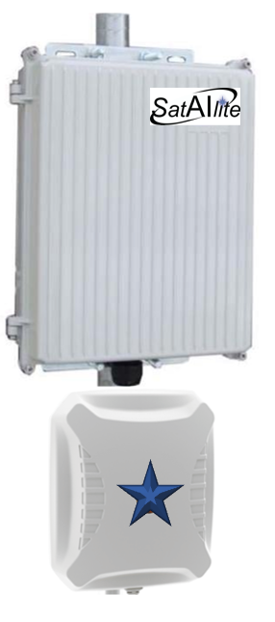
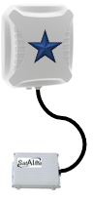
Data Sheet
Base-Station | Specification
Beacon ID | Factory Set, Unique Number
Power | 24VDC or 120VAC @60Hz 24VDC or 230VAC @50Hz
Receive Range | 150/300 ft. 45/91 m (Open Air)
Receive Interval | Continuous
Certifications | FCC, IC, ANATEL
Hazardous Area Certification | UL, Ex, Class I Div. I. II (A-D) ATEX
Enclosure Rating | IP67, NEMA 4X
Charge Beacon | Specification
Beacon ID | Factory Set, Unique Number
Power | 24VDC or 120VAC @60Hz 24VDC or 230VAC @50Hz
Transmission Range 4W | 150/300 ft. 45/91 m (Open Air)
Transmission Interval | Continuous
Certifications | FCC, IC, ANATEL
Hazardous Area Certification | UL, Ex, Class I Div. I. II (A-D) ATEX
Enclosure Rating | IP67, NEMA 4X
Machinery Monitoring Systems, LLC ·· 10421 Lexington Drive, Suite D·· Knoxville, TN 37932

Slide 4
Data Sheet
International Operating Frequencies
Region | Frequency Range
Australia | 918-926 / 920-926 MHz
Brazil | 902-907.5 / 915-928 MHz
Europe | 865.6-867.6 MHz
India | 865-867 MHz
Israel | 915-917 MHz
Japan | 916.7-920.9 / 916.7-923.5 MHz
North America | 902-928 MHz
Singapore | 866-869 / 920-925 MHz
Machinery Monitoring Systems, LLC ·· 10421 Lexington Drive, Suite D·· Knoxville, TN 37932

